Slide 1

Ang Biblia . . . Pinasimple
The Bible…Basically Ministries International Inc. Fort Worth, Texas
www.biblebasically.com
©2003 TBBMI
9.65.08.
01

Slide 2


( Ang Pagkukuwento ay sya pa ring Importanteng Kuro-kuro’)
®
Ang Biblia Pinasimple
Ika- walong parte
ANG SIMULA NG MGA AKLAT:
ANG PAGSAMA-SAMA NG MGA AKLAT SA BAGONG TIPAN
9.65.08.
©2006 TBBMI
02
Notes:
Remembering that the Biblical story line is still the basic idea…
we move now to the second part of SETTING UP THE BOOKS…
where the “NEW” Testament comes together

Slide 3
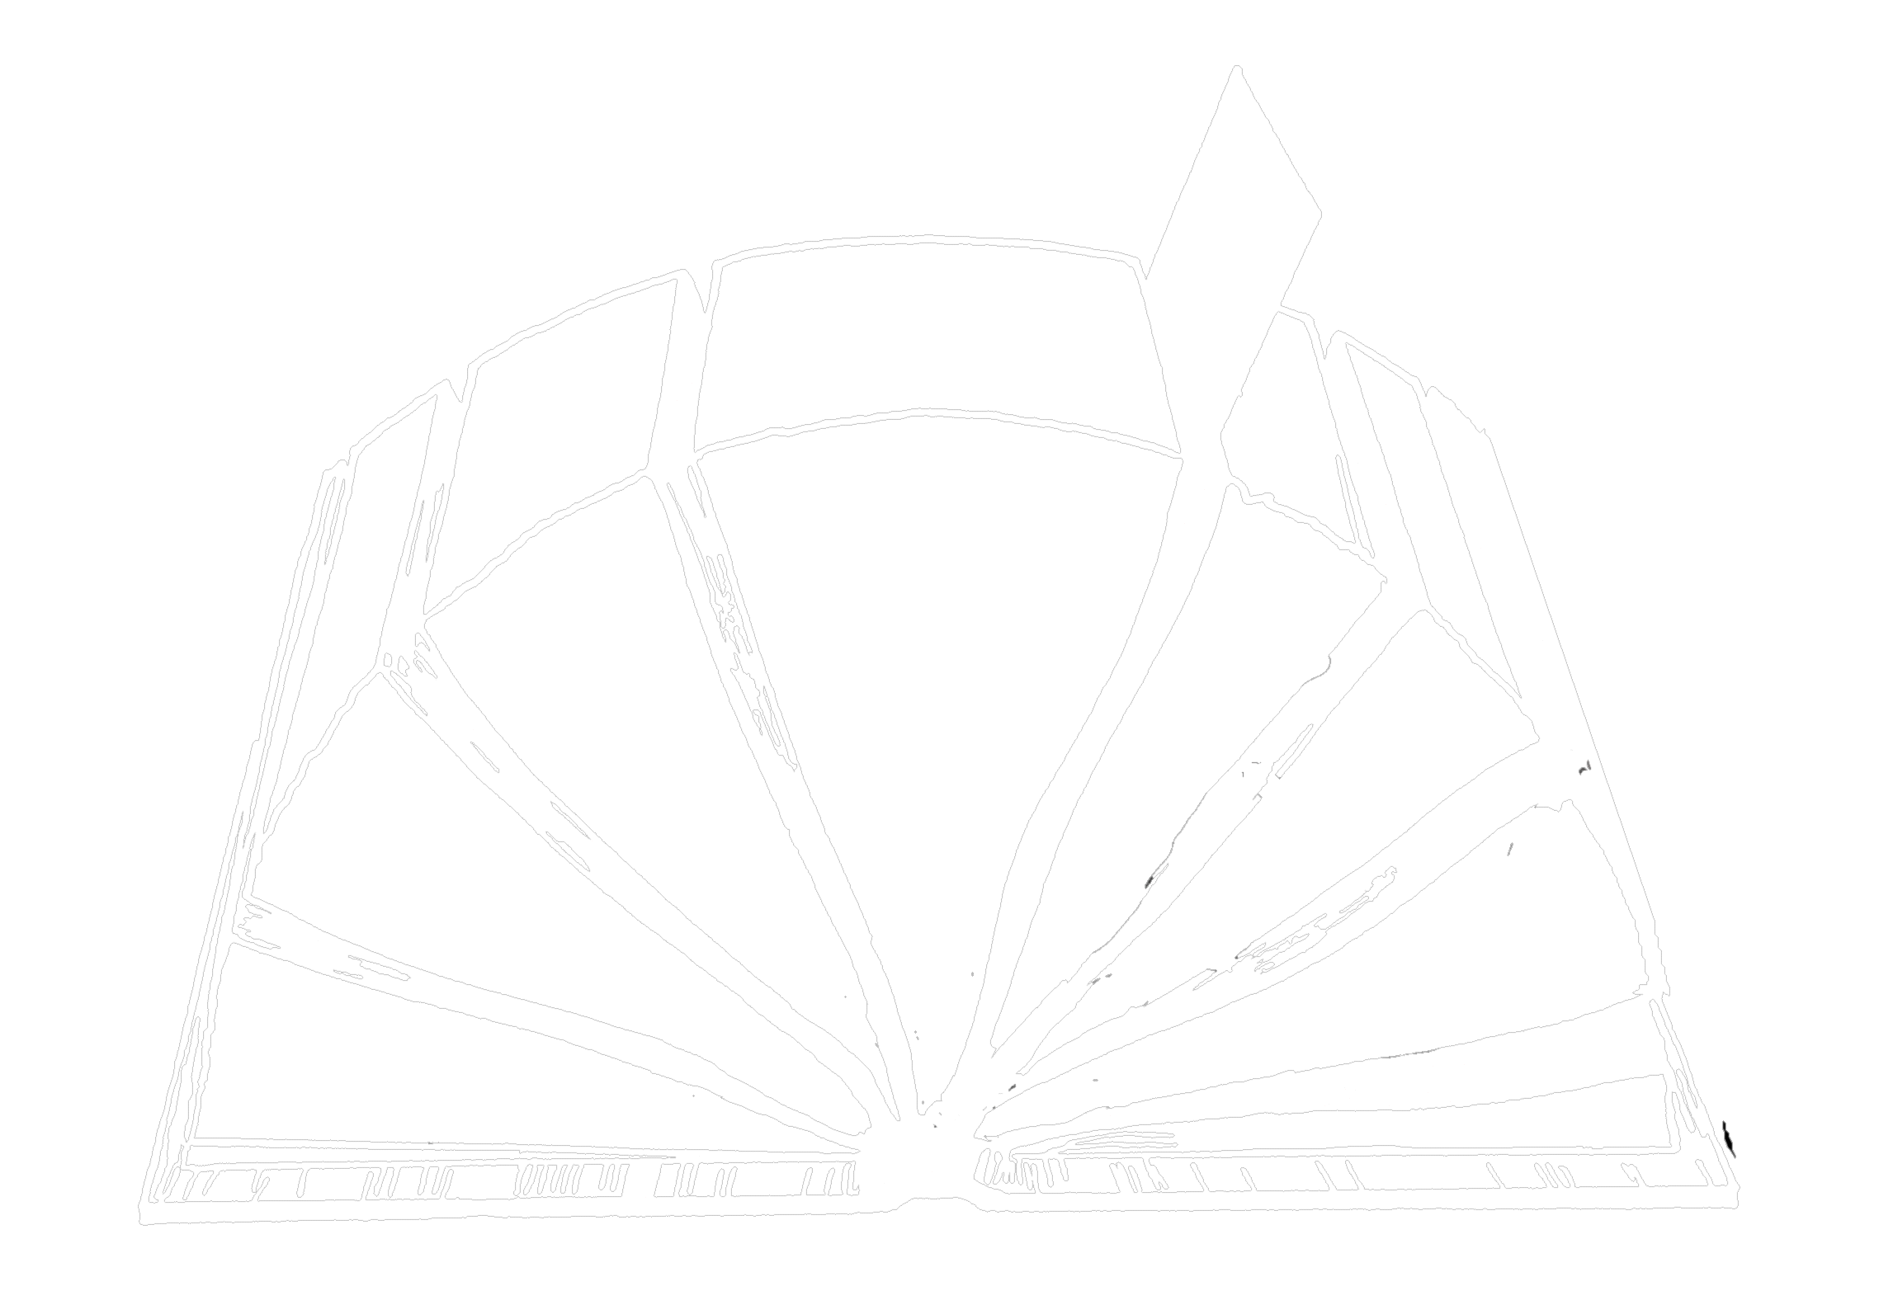
ANG PAGSAMA-SAMA NG MGA AKLAT SA BAGONG TIPAN
4
3
5
ANG MGA EBANGHELYO
6
2
ANG MGA PROPESIYA
ANG MGA SINULAT
ANG MGA GAWA
7
ANG MGA KASAYSAYAN
1
ANG MGA SULAT
ANG BATAS
8
ANG PAHAYAG
Ang “Bukas” na Biblia
03
Notes:
Here are The New Testament’s 27 books….the other half of that Opened Bible graphic we worked with earlier.

Slide 4
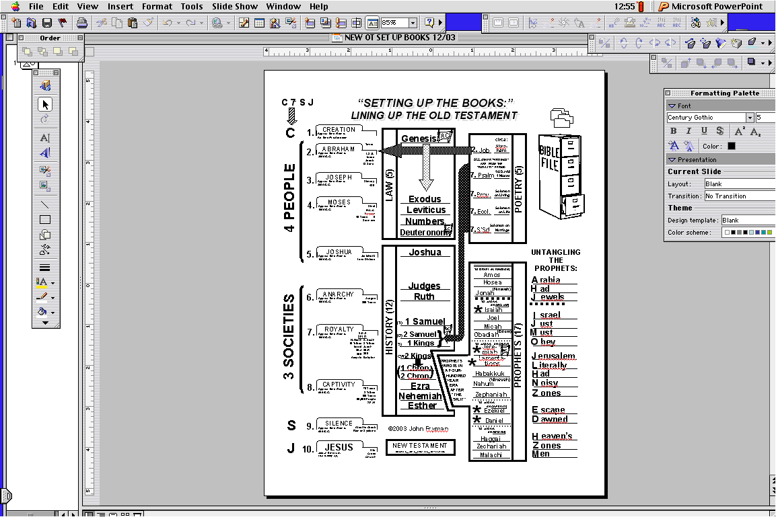
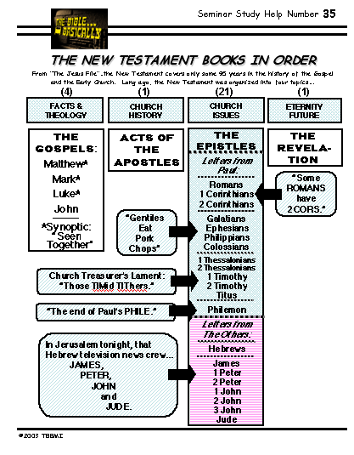
ANG PAGSAMA-SAMA NG MGA AKLAT SA BAGONG TIPAN
“ANG SIMULA NG MGA AKLAT”
ANG IYONG GABAY SA PAG-AARAL
ANG 39 NA MGA AKLAT
ANG 27 NA MGA AKLAT
SA LUMANG TIPAN
SA BAGONG TIPAN
Nahum
(Niveveh)‏
Zephaniah
04
1
Notes:
Here again is the Old Testament Study Help #19 and #34 we just finished.
//// And you’ll quickly see that the New Testament Study Help looks quite different. But it, too, is organized into four divisions – according to the right side of that “OPENED BIBLE” study help – just as the Old Testament study help completed before matched those on the left side of the “OPENED BIBLE” graphic.

Slide 5
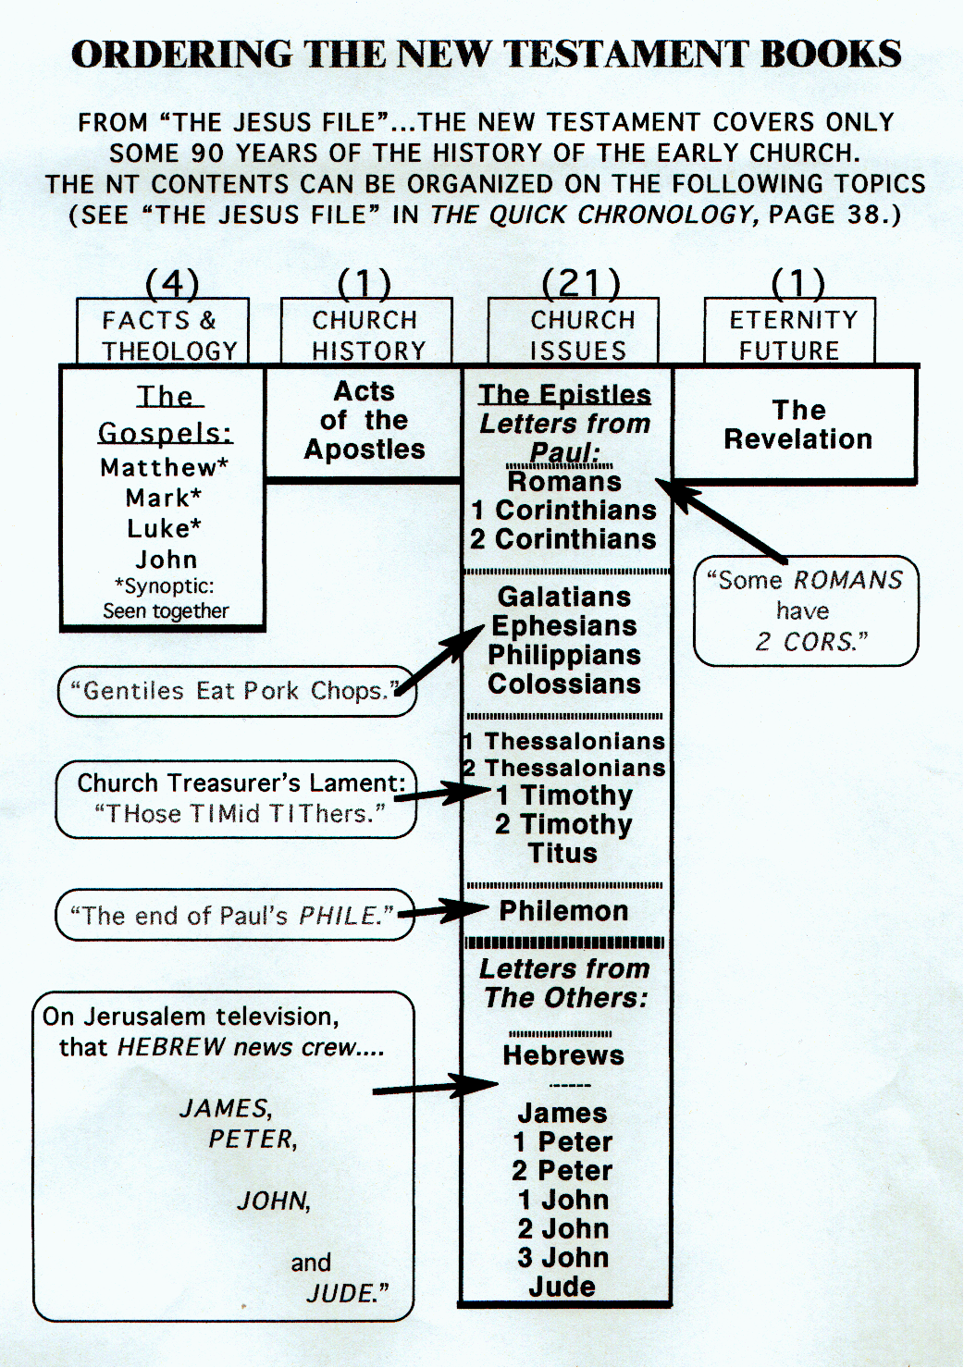
ANG PAGSAMA-SAMA NG MGA AKLAT SA BAGONG TIPAN
TULONG SA PAG-AARAL #20
ANG MGA
EBANGHELYO
ANG MGA GAWA
ANG MGA SULAT
ANG PAHAYAG
05
Notes:
So…using Study Help #20 as your worksheet, let’s look at it closely as “THE NEW TESTAMENT COMES TOGETHER.”
//// We begin on the left with THE FACTS AND THEOLOGICAL FOUNDATIONS…these are THE GOSPELS. We’ll fill in the blanks on the Study Guide as we go forward.

Slide 6
ANG PAGSAMA-SAMA NG MGA AKLAT SA BAGONG TIPAN
ANG MGA
EBANGHELYO
ANG MGA GAWA
ANG MGA SULAT
ANG
PAHAYAG
06
Notes:
The next column presents CHURCH HISTORY…THE ACTS OF THE APOSTLES.

Slide 7
ANG PAGSAMA-SAMA NG MGA AKLAT SA BAGONG TIPAN
ANG MGA EBANGHELYO
ANG MGA GAWA
ANG MGA SULAT
ANG
PAHAYAG
07
Notes:
Then on to CHURCH ISSUES…these are THE EPISTLES or letters of
the early church.

Slide 8
ANG MGA EBANGHELYO
ANG MGA GAWA
ANG MGA SULAT
ANG
PAHAYAG
08
Notes:
And finally that glimpse into eternity future…presented in THE REVELATION. Imagine it as one bookend to Scripture that matches the first twelve chapters of Genesis in the Bible’s beginning pages, the other bookend that we talked about earlier.

Slide 9
ANG PAGSAMA-SAMA NG MGA AKLAT SA BAGONG TIPAN
ANG MGA EBANGHELYO
ANG MGA GAWA
ANG MGA SULAT
ANG
PAHAYAG
09
Notes:
Here is the complete Study Guide...the Gospels…the Acts…the Epistles…and the Revelation..as it will appear when we finish unpacking it. So...let's begin.

Slide 10
ANG PAGSAMA-SAMA NG MGA AKLAT SA BAGONG TIPAN
ANG LUMANG TIPAN: 1,500 NA TAON
ANG BAGONG TIPAN: 40-50 NA TAON
4
3
5
6
2
ANG MGA PROPESIYA
ANG MGA EBANGHELYO
ANG MGA SINULAT
ANG MGA GAWA
7
ANG MGA KASAYSAYAN
1
ANG MGA SULAT
ANG BATAS
ANG PAHAYAG
8
ANG PANAHONG ITINALAGA SA PAGSULAT NG BIBLIA...
10
1
Notes:
To frame this study...think about this...the Old Testament required some 1,500 years for writing its 39 books...but, interestingly…
//// …the New Testament extends through only about 100 years of its own and the world's history. But for the actual writing of its 27 books, only some 40-50 years. Once again...we’ll be placing these books in a broader context of meaning and application.

Slide 11
ANG PAGSAMA-SAMA NG MGA AKLAT SA BAGONG TIPAN
ANG APAT NA BAHAGI NGA BAGONG TIPAN:
ISINULAT SA PAGITAN NG A.D. 40s AT 90s
( Ang 4 na Aklat )
( Ang 1 Aklat )
( Ang 21 na Aklat)
( Ang 1 Aklat )
MGA
KATOTOHANAN
AT TEOLOHIYA
ANG
KASAYSAYAN
NG IGLESIYA
ANG MGA
SULIRANIN
NG IGLESIYA
KAWALANG-
HANGGANG
HINAHARAP
Ang mga
Gawa
ng mga
Apostoles
Ang mga
Sulat
Ang Mga
Ebanghelyo
Ang
Pahayag
11
6
Notes:
Here are the four large traditional organizational sections of THE NEW TESTAMENT.
//// This is the place in THE BIBLE…BASICALLY where “The New Testament Comes Together.”
//// First, THE GOSPELS...laying out the basic facts and theology of the New Testament era. In parenthesis: you’ll see that there are FOUR books involved here.
//// Second, THE ACTS OF THE APOSTLES...this is church history at its very foundation stones...how the Gospel was spread through much of the Ancient Near East and its introduction into Europe and Asia. Note that only ONE book comprises the Acts of the Apostles.
//// Third, THE EPISTLES...as we said…these are letters, sometimes simple person-to-person writings, and sometimes grand and complex explanations and expositions of the new Christian theology. They address an enormous array of NEW TESTAMENT issues...circumstances that no man had ever faced before, simply because the Church was a totally new organization...an organism, really...newly introduced into the life of the planet. Paul the Apostle calls it, formerly, a mystery. The number of Epistles: TWENTY-ONE different letters to various audiences on a variety of theological and personal subjects.
//// And fourth, THE REVELATION...that intriguing glance into Eternity Future where all of earth's history approaches its climax, revealing the Father's Plan for man's final redemption, first played out and begun through old Abraham, extending through the ministry of the Messiah in ancient Israel, and reaching its culmination with His return in the problematic End Times. This is pure prophecy.
Number of books, only ONE; remarkable when we compare it with almost two dozen books of prophecy in the Old Testament.
//// All of these books were written somewhere across the A.D. 40s to the 90s.

Slide 12
ANG PAGSAMA-SAMA NG MGA AKLAT SA BAGONG TIPAN
(Ang 4 na Aklat)
MGA
KATOTOHANAN
AT TEOLOHIYA
ANG MGA
EBANGHELYO:
( Ang 4 na Aklat)
MGA
KATOTOHANAN
AT TEOLOHIYA
Mateo*
Markus*
Lukas*
Juan
*sinoptik:
Tungkol sa buhay
at ministeryo ni
Hesus na makikita
sa apat na aklat
Ang mga
Ebanghelyo
12
3
Notes:
The first section of the New Testament: THE GOSPELS...THE FACTS AND THE THEOLOGY, clearly set out in four books, all of which form the framework for all the rest of the New Testament – and the future of the Church and of all Christianity for all time…for that matter!
//// Here they are, in four books: MATTHEW, MARK, LUKE and JOHN. These are THE GOSPELS, the Good News of the Ministry of the Lord Jesus Christ.
//// Notice that the first three Gospels –– MATTHEW, MARK, AND LUKE –– each have an asterisk by their names.
//// These books are gathered into a special sub-group we call SYNOPTIC...a word meaning “to see together”...in that the text of these books view the ministry of Jesus Christ from a special perspective that differs from that of the Gospel of John. Let's talk about that

Slide 13



“ANG BUONG PAGLALARAWAN SA BUHAY NG PANGINOONG HESU- KRISTO”
NA MAKIKITA SA 4 NA MAGKAIBANG ANGGULO
TULONG SA PAG-AARAL #21
13
2
Notes:
Using Study Help #21, through this large picture frame…
we’re going to create a graphic representation called
//// A FINISHED PORTRAIT OF THE LORD JESUS CHRIST… but…
//// …we’re going to compose that portrait through four different literary lenses
as the completed image develops.

Slide 14
Mula sa bawat manunulat ng Ebanghelyo ay mapapansin ang mga nakasaad sa ibaba:
• Ang kanyang piniling tagapakinig
• Ang kanyang bukod-tanging paglalahad sa pagkatao ng Panginoong Hesu-Kristo
• Ang pinakamahalagang layunin na inihahatid ng bawat Ebanghelyo
• Mga posibleng taon/panahon kung kailan isinulat ang bawat Ebanghelyo
14
4
Notes:
From each Gospel writer…
//// …we’ll discover the specific audience for his writings…
//// …with his unique presentation of the person of Jesus Christ…
//// …suggesting a foundational purpose communicated through the text of his Gospel…
//// …followed by the scholars’ estimate of the date of each writing.

Slide 15
APAT NA MAGKA-IBANG PAGLALARAWAN…
1
2
3
4
15
Notes:
Now, please…in your imagination…insert four smaller picture frames into the larger one. In each frame install four lines. As we fill them in we’ll have some specific information about the purpose and function of each of the four Gospels. The individual “sub-frames” are designated 1 through 4.

Slide 16
ANG BALANGKAS NG BAWAT EBANGHELYO…
1
MATEO
2
MARKUS
3
LUKAS
4
JUAN
16
3
Notes:
Each of the frames now gets its name... MATTHEW in the first...
//// MARK, second...
//// LUKE, third...and finally, the fourth…
//// JOHN, the names of the Gospels in the order of their appearance in the New Testament canon...the official collection of Biblical writings.

Slide 17
ANG PINILING TAGAPAKINIG NG BAWAT EBANGHELYO…
1
MATEO
2
MARKUS
SA MGA:
HUDEO
SA MGA:
ROMANO
3
4
3
LUKAS
4
JUAN
SA MGA:
GRIYEGO
SA MGA:
IGLESIYA
17
4
Notes:
Now comes an idea endorsed by Biblical scholars around the world…having to do with the audiences TO WHICH each Gospel was written.
For instance…
//// MATTHEW penned his work specifically toward his brothers and sisters in the Jewish audience. He makes repeated references to a regnant Jesus, seeing him as the Messiah and the King of the Chosen People.
//// For MARK, his work is widely regarded as directed toward the Romans, then occupying his native land and into the farther parts of the ancient world. MARK is brief, to the point. And, in fact, repeatedly he uses such term as "straightway" in early translations…all in a get-the-job-done mentality, which characterized the Roman way of thinking and doing things.
//// While LUKE, the physician, is the highly intellectual Greek who accompanied Paul on his tours. For LUKE, his Gospel audience was the Greeks, and in other words, to the Gentile world in general.
Also as the author of The Acts, Luke set down for all time a detailed account of the development of the early church and its wide-spread missionary ministries, to which he was a witness.
//// Finally, we come to the gospel of JOHN, whose audience differs markedly from the first three. John is written directly to UNBELIEVERS, AND REACHING THEM THROUGH THE COMMUNICATION CHANNEL OF THAT NEW ORGANISM, THE CHURCH. In fact, when you read John's gospel, you are struck with the fact that his work carries with it a somewhat mystical quality, certainly not the quick, even terse recounting of facts as we find in Mark’s Gospel. John's audience –– the Church itself, the members of the new Organism, bathed in the redemptive love of Christ –– receives his brilliant articulation of the impact of the coming of the Holy Spirit, now –after the Day of Pentecost -- having taken up permanent residence in the heart of each new believer.
So there are four individual audiences to which the Gospels were specifically directed at the time of their writing. That one insight, alone, gives a new way to categorize and individualize the Gospel writings.

Slide 18
…ANG PAGLALARAWAN KAY HESUS BILANG…
2
1
2
1
MATEO
MARKUS
SA MGA:
HUDEO
SA MGA:
ROMANO
BILANG:
HARI
BILANG: LINGKOD
4
3
4
3
JOHN
LUKAS
JUAN
TO:
CHURCH
SA MGA:
GRIYEGO
TO:
IGLESIYA
SA MGA:
BILANG:
DIOS/TAO
BILANG:
DIOS
18
4
Notes:
Another question: How does each Gospel portray The Lord as a Man and as Immanuel, “God With Us?”
//// For MATTHEW...Christ is seen as King of the Jews. Repeatedly Matthew describes how Jesus is the fulfillment of Old Testament Scripture. Matthew makes wide use of Jewish terminology of royalty.
//// For MARK...He is seen as the Servant of all...some say the Suffering Servant, and traditionally associated with an audience in Rome and among the widespread Roman world.
//// LUKE sees Christ as the God-Man -- truly God and truly Man. Not that the others would infer otherwise, necessarily. But Luke manifests that idea clearly, at the front of his work and as a continuing subtext of his writings.
//// Finally, John’s Gospel. Clearly and above all else...JOHN portrays Christ as God Himself. JOHN uses his pen to communicate the mystery and the power of the Messiah. Why? Because John experienced a particular closeness to the Master, one that was apparently unique among the disciples. Remember too that this was this same JOHN who was destined to see and write down the great End-Times vision we know as The Revelation.

Slide 19
SA MAIKLING SALITA, ANG MENSAHE SA BAWAT EBANGHELYO AY…
1
MATEO
2
MARKUS
SA MGA:
HUDEO
SA MGA:
ROMANO
BILANG:
HARI
BILANG:
LINGKOD
ANO ANG KANYANG:
ANO ANG KANYANG:
GINAWA
SINABI
3
LUKAS
4
JUAN
SA MGA:
GRIYEGO
SA MGA:
IGLESIYA
BILANG:
DIOS/TAO
BILANG:
DIOS
ANO ANG KANYANG:
DINANAS
ANO ANG KANYANG:
IBIG IPABATID
19
5
Notes:
Here is a last set of interesting ideas, with thanks to some anonymous believer who developed them years ago.
//// Call it “the message in a nutshell.” Question: what is the one single word that might characterize the message of each Gospel?
//// For MATTHEW...that book tells us what Jesus Christ SAID.
//// MARK tells us what He DID.
//// LUKE shows us clearly what the Messiah FELT.
//// And JOHN, with enormous clarity, tells us what Christ MEANT!
What he SAID...what He DID...what He FELT...and what He MEANT!
These single-word ideas help us to tightly focus on the remarkable differences that exist among the Gospel writings. For many Bible readers, such distinctives are unfamiliar territory.

Slide 20
ISANG DI-PANGKARANIWANG SALITA…
SINOPTIK:
1
MATEO
2
MARKUS
SA MGA:
HUDEO
SA MGA:
ROMANO
BILANG:
HARI
BILANG:
LINGKOD
ANO ANG KANYANG:
ANO ANG KANYANG:
GINAWA
SINABI
SINOPTIK
“TINGNAN
ANG KABUUAN”
“TINGNAN ANG KABUUAN”
3
LUKAS
4
JUAN
SA MGA:
GRIYEGO
SA MGA:
IGLESIYA
BILANG:
DIOS/TAO
BILANG:
LINGKOD
ANO ANG KANYANG:
DINANAS
ANO ANG KANYANG:
IBIG IPABATID
19
5
Notes:
Here is a last set of interesting ideas, with thanks to some anonymous believer who developed them years ago.
//// Call it “the message in a nutshell.” Question: what is the one single word that might characterize the message of each Gospel?
//// For MATTHEW...that book tells us what Jesus Christ SAID.
//// MARK tells us what He DID.
//// LUKE shows us clearly what the Messiah FELT.
//// And JOHN, with enormous clarity, tells us what Christ MEANT!
What he SAID...what He DID...what He FELT...and what He MEANT!
These single-word ideas help us to tightly focus on the remarkable differences that exist among the Gospel writings. For many Bible readers, such distinctives are unfamiliar territory.

Slide 21
ANG SINOPTIK: ”TINGNAN ANG KABUUAN”
1
MATEO
2
MARKUS
SA MGA:
HUDEO
SA MGA:
ROMANO
BILANG:
HARI
BILANG:
LINGKOD
ANO ANG KANYANG:
ANO ANG KANYANG:
GINAWA
SINABI
∑
3
LUKAS
4
JUAN
SA MGA:
GRIYEGO
SA MGA:
IGLESIYA
BILANG:
DIOS/TAO
BILANG:
LINGKOD
ANO ANG KANYANG:
DINANAS
ANO ANG KANYANG:
IBIG IPABATID
19
5
Notes:
Here is a last set of interesting ideas, with thanks to some anonymous believer who developed them years ago.
//// Call it “the message in a nutshell.” Question: what is the one single word that might characterize the message of each Gospel?
//// For MATTHEW...that book tells us what Jesus Christ SAID.
//// MARK tells us what He DID.
//// LUKE shows us clearly what the Messiah FELT.
//// And JOHN, with enormous clarity, tells us what Christ MEANT!
What he SAID...what He DID...what He FELT...and what He MEANT!
These single-word ideas help us to tightly focus on the remarkable differences that exist among the Gospel writings. For many Bible readers, such distinctives are unfamiliar territory.

Slide 22
JUAN: BUUIN ANG MENSAHE
1
MATEO
2
MARKUS
SA MGA:
HUDEO
SA MGA:
ROMANO
BILANG:
HARI
BILANG:
LINGKOD
∑
ANO ANG KANYANG:
ANO ANG KANYANG:
GINAWA
SINABI
3
LUKAS
4
JUAN
SA MGA:
GRIYEGO
SA MGA:
IGLESIYA
BILANG:
DIOS/TAO
BILANG:
LINGKOD
ANO ANG KANYANG:
DINANAS
ANO ANG KANYANG:
IBIG IPABATID
19
5
Notes:
Here is a last set of interesting ideas, with thanks to some anonymous believer who developed them years ago.
//// Call it “the message in a nutshell.” Question: what is the one single word that might characterize the message of each Gospel?
//// For MATTHEW...that book tells us what Jesus Christ SAID.
//// MARK tells us what He DID.
//// LUKE shows us clearly what the Messiah FELT.
//// And JOHN, with enormous clarity, tells us what Christ MEANT!
What he SAID...what He DID...what He FELT...and what He MEANT!
These single-word ideas help us to tightly focus on the remarkable differences that exist among the Gospel writings. For many Bible readers, such distinctives are unfamiliar territory.

Slide 23
JUAN: BUUIN ANG MENSAHE
KAPITULO 1:
ANG 6 NA MAHALAGANG KATOTOHANAN TUNGKOL KAY
HESU-KRISTO!
BERSIKULO I: SIYA ay nandiyan sa mulat-mula pa
Ang Katauhan NIYA ay bukod-tangi
SIYA ang Panginoon noon, ngayon at sa walang hanggan.
Nang pasimula siya ang Verbo, at ang Verbo ay sumasa Dios, at ang Verbo ay Dios.
GABAY SA PAG-AARAL #22
23
3
Notes:
We find brief, definitive answers to those statements or questions in John’s first chapter. Follow along with Study Help #22. There are
//// SIX GREAT TRUTHS of Jesus Christ. John lists them.
//// Verse One: He is portrayed as the Pre-existent One, a Person Distinct, but Who WAS and IS God.
//// Verse One reads: “In the beginning was the Word, and the Word was with God, and the Word was God.”

Slide 24
JUAN: BUUIN ANG MENSAHE
ANG 6 NA MAHALAGANG KATOTOHANAN TUNGKOL KAY
KAPITULO 1:
HESU-KRISTO!
BERSIKULO I: SIYA ay nandiyan sa mulat-mula pa
Ang Katauhan NIYA ay bukod-tangi.
SIYA ang Panginoon noon, ngayon at sa walang hanggan.
Ito rin nang pasimula'y sumasa Dios.
BERSIKULO 2: SIYA ay nandiyan magpawalang-hanggan.
23
3
Notes:
We find brief, definitive answers to those statements or questions in John’s first chapter. Follow along with Study Help #22. There are
//// SIX GREAT TRUTHS of Jesus Christ. John lists them.
//// Verse One: He is portrayed as the Pre-existent One, a Person Distinct, but Who WAS and IS God.
//// Verse One reads: “In the beginning was the Word, and the Word was with God, and the Word was God.”

Slide 25
JUAN: BUUIN ANG MENSAHE
ANG 6 NA MAHALAGANG KATOTOHANAN TUNGKOL KAY
KAPITULO 1:
HESU-KRISTO!
BERSIKULO I: SIYA ay nandiyan sa mulat-mula pa.
Ang Katauhan NIYA ay bukod-tangi.
SIYA ang Panginoon noon, ngayon at sa walang hanggan.
Ang lahat ng mga bagay ay ginawa sa pamamagitan niya; at alin man sa lahat ng ginawa ay hindi ginawa kung wala siya.
BERSIKULO 2: SIYA ay nandiyan magpawalang-hanggan.
BERSIKULO 3: SIYA ang Maylikha ng Sandaigdigan.
23
3
Notes:
We find brief, definitive answers to those statements or questions in John’s first chapter. Follow along with Study Help #22. There are
//// SIX GREAT TRUTHS of Jesus Christ. John lists them.
//// Verse One: He is portrayed as the Pre-existent One, a Person Distinct, but Who WAS and IS God.
//// Verse One reads: “In the beginning was the Word, and the Word was with God, and the Word was God.”

Slide 26
JUAN: BUUIN ANG MENSAHE
ANG 6 NA MAHALAGANG KATOTOHANAN TUNGKOL KAY
KAPITULO 1:
HESU-KRISTO!
BERSIKULO I: SIYA ay nandiyan sa mulat-mula pa.
Ang Katauhan NIYA ay bukod-tangi.
SIYA ang Panginoon noon, ngayon at sa walang hanggan.
BERSIKULO 2: SIYA ay nandiyan magpawalang-hanggan.
Nasa kaniya ang buhay; at ang buhay ay siyang ilaw ng mga tao. At ang ilaw ay lumiliwanag sa kadiliman; at ito'y hindi napag-unawa ng kadiliman…Nagkaroon ng tunay na ilaw, sa makatuwid baga'y ang ilaw na lumiliwanag sa bawa't tao, na pumaparito sa sanglibutan.
BERSIKULO 3: SIYA ang Maylikha ng Sandaigdigan
BERSIKULO 4, 5, 9: SIYA ang Bukal ng lahat na Liwanag at Buhay.
23
3
Notes:
We find brief, definitive answers to those statements or questions in John’s first chapter. Follow along with Study Help #22. There are
//// SIX GREAT TRUTHS of Jesus Christ. John lists them.
//// Verse One: He is portrayed as the Pre-existent One, a Person Distinct, but Who WAS and IS God.
//// Verse One reads: “In the beginning was the Word, and the Word was with God, and the Word was God.”

Slide 27
… AT ANG TAON/PANAHON SA PAGSULAT?
1
MATEO
2
MARKUS
HUDEO
ROMANO
Taong
A.D.64-68
Taong A.D.40s
SA MGA:
SA MGA:
BILANG:
HARI
BILANG:
LINGKOD
ANO ANG KANYANG:
ANO ANG KANYANG:
GINAWA
SINABI
3
LUKAS
4
JUAN
Taong A.D.57-59
Taong A.D. 69 PAGKATAPOS ISULAT ANG SINOPTIK
SA MGA:
GRIYEGO
SA MGA:
IGLESIYA
BILANG:
DIOS/TAO
BILANG:
LINGKOD
ANO ANG KANYANG:
DINANAS
ANO ANG KANYANG:
IBIG IPABATID
19
5
Notes:
Here is a last set of interesting ideas, with thanks to some anonymous believer who developed them years ago.
//// Call it “the message in a nutshell.” Question: what is the one single word that might characterize the message of each Gospel?
//// For MATTHEW...that book tells us what Jesus Christ SAID.
//// MARK tells us what He DID.
//// LUKE shows us clearly what the Messiah FELT.
//// And JOHN, with enormous clarity, tells us what Christ MEANT!
What he SAID...what He DID...what He FELT...and what He MEANT!
These single-word ideas help us to tightly focus on the remarkable differences that exist among the Gospel writings. For many Bible readers, such distinctives are unfamiliar territory.

Slide 28
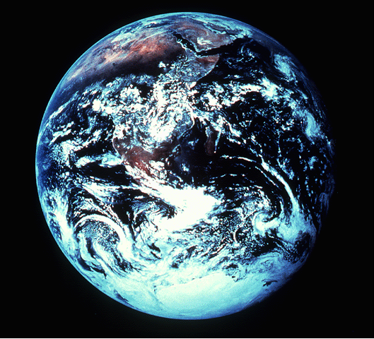
AT NGAYON…UPANG KOMPLETUHIN ANG PAGLALARAWAN…
Pahayag 1:12-18
¹²At ako'y lumingon upang makita ang tinig na nagsasalita sa akin. At nang ako'y lumingon ay nakita ko ang pitong kandelerong ginto:
MATEO
MARKUS
¹³At sa gitna ng mga kandelero ay may isang katulad ng isang anak ng tao, na may suot na damit hanggang sa paa, at may bigkis ang dibdib na isang pamigkis na ginto.
ANG PAHAYAG
NI HESU-KRISTO
KAY APOSTOL JUAN
¹⁴At ang kaniyang ulo at ang kaniyang buhok ay mapuputing gaya ng balahibong maputi ng tupa, gaya ng niebe; at ang kaniyang mga mata ay gaya ng ningas ng apoy;
¹⁵At ang kaniyang mga paa ay katulad ng tansong binuli, na gaya ng dinalisay sa isang lutuang-bakal; at ang kaniyang tinig ay gaya ng lagaslas ng maraming tubig.
16At sa kaniyang kanang kamay ay may pitong bituin: at sa kaniyang bibig ay lumabas ang isang matalas na tabak na may dalawang talim: at ang kaniyang mukha ay gaya ng araw na sumisikat ng matindi.
LUKAS
JUAN
¹⁷At nang siya'y aking makita, ay nasubasob akong waring patay sa kaniyang paanan. At ipinatong niya sa akin ang kaniyang kanang kamay, na sinasabi, Huwag kang matakot; ako'y ang una at ang huli,
¹⁸At ang Nabubuhay; at ako'y namatay, at narito, ako'y nabubuhay magpakailan man, at nasa akin ang mga susi ng kamatayan at ng Hades.
28
9
Notes:
Now…to complete the portraits given to us by
MATTHEW…MARK…LUKE…and JOHN.
//// For this, we need to get out into space and look at this unfortunate planet. Man has made a mess of it, you will probably agree. This view of earth helps us more clearly understand the final view of Christ given to us in the New Testament.
//// Now travel to the last book of the New Testament…The Revelation of Jesus Christ to John the Apostle. There, we see Jesus Christ in His risen, ascended glory, as he will appear when He returns at the end of History to reclaim all that is His.
//// In his first chapter of The Revelation, John writes this:
I turned around to see the voice that was speaking to me. And when I turned I saw seven golden lamp stands…
//// and among the lamp stands was someone “like a son of man,” dressed in a robe reaching down to his feet and with a golden sash around his chest.
//// His head and hair were white like wool, as white as snow, and his eyes were like blazing fire.
//// His feet were like bronze glowing in a furnace, and his voice was like the sound of rushing waters.
//// In his right hand he held seven starts, and out of his mouth came a sharp double-edged sword. His face was like the sun shining in all its brilliance.
//// When I saw him, I fell at his feet as though dead. Then he placed his right hand on me and said: “Do not be afraid. I am the First and the Last.
//// I am the Living one; I was dead, and behold I am alive forever and ever! And I hold the keys the death and Hades.

Slide 29

ANG BUONG PAGLARAWAN SA BUHAY NG PANGINOONG HESU KRISTO
“…. at pagpapalain sa iyo ang lahat ng angkan sa lupa."
Genesis 12:3b
29
1
Notes:
With this FINISHED PORTRAIT OF THE LORD JESUS CHRIST! We now have a more secure handle on the four Gospels as the beginning documentation of the New Testament -- out of which every succeeding New Testament idea and historical event unfolds.
…And we can see once again the enormous importance of the
Abrahamic Covenant promises…especially Genesis 12:3. Remember that ancient promise to Abraham.
//// God promised the Hebrew patriarch that “I will bless those who bless you, and whoever curses you I will curse…AND ALL PEOPLES ON EARTH WILL BE BLESSED THROUGH YOU.” That blessing was realized in the Messiah’s glorious advent into the earth. Now let's go along farther.

Slide 30
ANG APAT NA BAHAGI NGA BAGONG TIPAN :
ISINULAT SA PAGITAN NG A.D. 40s AT 90s
( Ang 4 na Aklat )
( Ang 1 Aklat )
( Ang 21 na Aklat)
( Ang 1 Aklat)
MGA
KATOTOHANAN
AT TEOLOHIYA
ANG
KASAYSAYAN
NG IGLESIYA
ANG MGA
SULIRANIN
NG IGLESIYA
KAWALANG-
HANGGANG
HINAHARAP
Ang Mga
Ebanghelyo
Ang mga
Gawa
ng mga
Apostoles
Ang mga
Sulat
Ang
Pahayag
30
Notes:
Now we come to a single remarkable recounting of the history of the early church and the opening of the concept of “mission”...that single book known as THE ACTS OF THE APOSTLES.

Slide 31
Ang Kasaysayan sa Nangyaring Kaganapan
Mga Pangunahing
Tauhan:
Isinulat ng manggagamot na si Lukas sa kahulihang panahon ng A.D. 50s
( Ang 1 Aklat )
• Pablo
• Pedro
• Bernabe
• Juan Markus
• Timoteo
• Felipe
• Lukas (Ang May-Akda)
ANG
KASAYSAYAN
NG IGLESIYA
Ang mga
Gawa
ng mga
Apostoles
31
8
Notes:
As a history of the resulting events…..THE ACTS almost certainly were written by Dr. Luke. It gives us vital detail of the lives of those who experienced that early history…
//// …thorough the lives of its major characters,
//// Paul,
//// Peter,
//// Barnabas,
//// young John Mark,
//// Timothy,
//// Philip,
//// And Dr. Luke…the Author Himself, and a cast of other
characters moving in and out of the story…a work almost certainly written during the late A.D. 50s, all First Century events. Scholars tell us that, given the enormous store of detail and coincident events checked by secular sources, the book of Acts has that ring of absolute truth. Events that really happened. Characters who really lived. To read of their lives and their progress in Christian growth –– especially in missions –– is to deliver to us lessons of incredible spiritual value and encouragement….not to mention operational strategies.

Slide 32
Ang Komisyon at Asensyon ni Hesus
Pentekost: Ang Kapanganakan ng Iglesiya
Ang Kagalingan ng Mamang Pilay
Ang Pinakaunang Pag-uusig
Ananias at ang asawang si Safira
Mga Pinakaunang Dyakono
Si Esteban atkanyang
1
2
3
4
5
6
7
SA
JERUSALEM Kap. 1-7
ANG PAGSAMA-SAMA NG MGA AKLAT SA BAGONG TIPAN
ANG WALANG-KATAPOSANG DULA SA TATLONG BAHAGI
ISINILANG ANG IGLESIYA…
AT TAYO AY NANDITO NGAYON!
“…at kayo'y magiging mga saksi ko sa Jerusalem, at sa buong Judea at Samaria, at hanggang sa kahulihulihang hangganan ng lupa.
Mga Gawa 1:8b
ANO ANG GINAGAWA NATIN UKOL DITO?
8
9
10
11
12
Si Felipe at ang Bating
Ang Pagbabalik- loob ni Pablo: Ang Damasco
Si Pedro at Cornelio
Ipinagtanggol ni Pedro ang ministeryo sa mg Hentil
Ang Pagmamalupit ni Herodes sa mga Kristiyano
SA
PALESTINA AT SIRYA Kap. 8-12
Gabay sa Pag-aaral #23
13
14
15
16
17
18
19
20
21
22
23
24
25
26
27
28
ANG PALATANDAAN NG MGA GAWA NG MGA APOSTOLES
Si Pablo bilang Misyonero: Unang Paglalakbay
“
Ang Konseho ng Jerusalem
Ang Pangalawang Paglalakbay ni Pablo
“
“
Ang Pangatlong Paglalakbay ni Pablo
“
Pablo: Sa Jerusalem
Pablo: Ang pagtatangol sa harap ng marami
Pablol: Ang pagtatangolsa harap ng Sanedrin
Pablo: Ang pagtatanggol sa harap ni Felix
Pablo: Ang pagtatanggol sa harap ni Festo
Pablo: Ang pagtatangol sa harap ni hari Agripa
Ang Paglalayag papunta sa Roma: pagkawasak sa bapor
Si Pablo sa Roma
SA SAN
DAIGDIGAN! Kap. 13-28
©2006 TBBMI
32
5
Notes:
And the Program continues as the Church begins to spread. Study Help #23 lists an index to those glorious adventures in The Acts of the Apostles. Its 28 dramatic chapters clearly divide its progress…
//// Chapters 1 through 7, set in Jerusalem, begin with Jesus’ further Commission to spread the Gospel through witnessing to his ministry “in Jerusalem, and in all Judea, and Samaria, and to the ends of the earth.”
//// Chapters 8 through 12 expand the cast to include Philip, Paul and Peter. Persecution occurs and the church begins to move out into the surrounding regions and provinces…Palestine and Syria!
//// AND INTO THE WORLD! The remainder of the book –– Chapters 13 through 28 –– establishes THE MISSIONARY AGENDA of the early church. Paul is the central character as he expands the Gospel throughout the Mediterranean Basin. He is required to make studied responses to many of the leaders and thinkers of his day, ending in his final voyage to Rome where his courageous ministry ends.
//// Through its 28 chapters…THE ACTS presents an ageless drama in three episodes. The church is born in these pages…and here YOU AND I ARE LEFT TO CONTINUE THE WORK!
//// So the question remains: WHAT ARE WE DOING ABOUT IT? And the story moves on…

Slide 33
ANG APAT NA BAHAGI NGA BAGONG TIPAN :
ISINULAT SA PAGITAN NG A.D. 40s AT 90s
( Ang 4 na Aklat )
( Ang 1 Aklat )
( Ang 21 na Aklat)
( Ang 1 Aklat)
MGA
KATOTOHANAN
AT TEOLOHIYA
ANG
KASAYSAYAN
NG IGLESIYA
ANG MGA
SULIRANIN
NG IGLESIYA
KAWALANG-
HANGGANG
HINAHARAP
Ang mga
Gawa
ng mga
Apostoles
Ang mga
Sulat
Ang
Pahayag
Ang Mga
Ebanghelyo
33
Notes:
For that new organism, the Church, enormous unexpected and troubling issues emerged among the widespread congregations –– between the people themselves and also concerning their worship of the Lord. For those reasons, in the absence of printing, it was necessary to circulate instructive letters from the church leaders. They were known then and now as THE EPISTLES.

Slide 34
Ang Pagtutuwid sa mga Paglalakbay ni Pablo
Alam Niyo ba na ang mapa sa hulihan ng yong Bibliya…yong may mga tuldok-tuldok na linya…yong may mga gatlang…at mga linya ng mga maliliit na at iba’t-ibang kulay na bilog, at madalas nakatatak sa ibabaw ng bawat isa!
34
1
Notes:
One way to frame these problems and to appreciate the daunting challenge of the task of missions –– then and now –– is to appreciate and to straighten out Paul’s wide travels! For most people…Paul’s trips have always been – to say the least – geographically confusing!
//// You know that map in the back of your Bible…the one with all the dotted lines…the dashed lines…straight lines…lines with little circles…lines of different colors…and often all of them PRINTED ON TOP OF EACH OTHER.

Slide 35
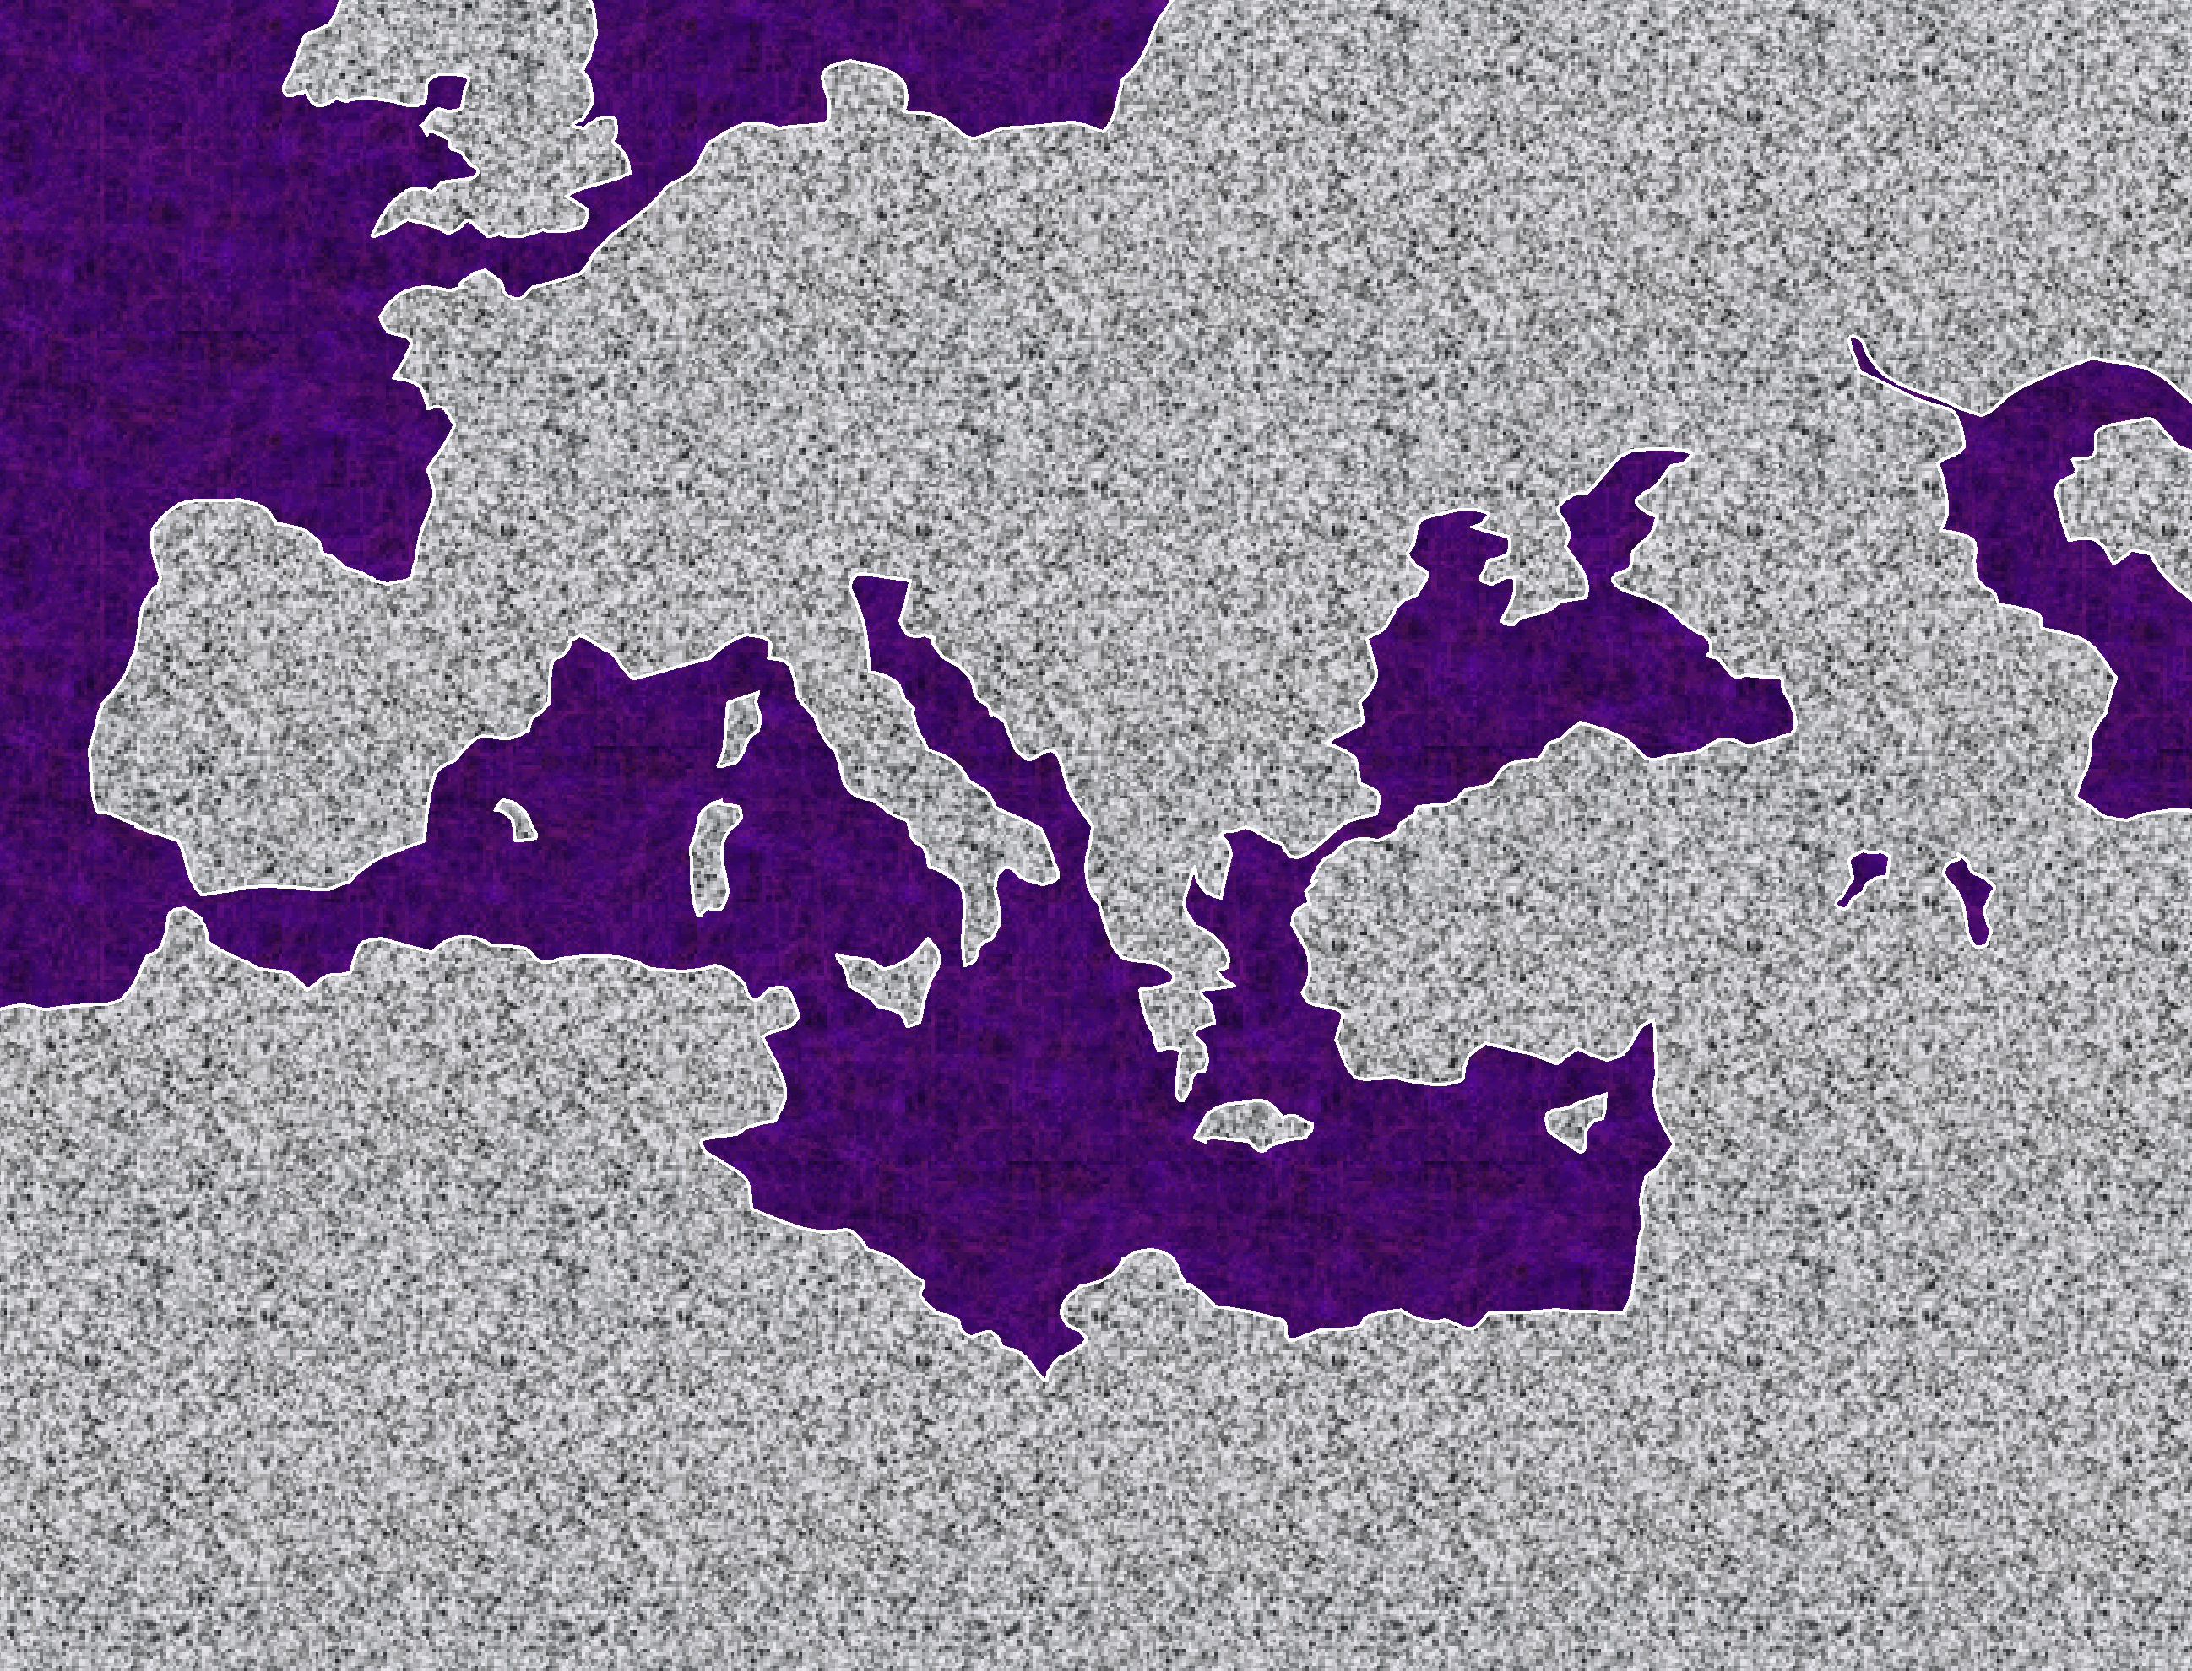
Si Pablo ay talagang manlalakbay…at ito ay sa halos lahat ng nasasakupan ng Mediteraneo!
OKEANONGANTARTIKO
ASYA
ANG KATAHIMIKAN
SI ALEX, ANG GRIYEGO
DAGAT MEDITERANEO
ANG KAPARAAN NG ROMA
ARABYA
APRIKA
35
Notes:
Understand this! Paul was a real world traveler! And he was all over the Mediterranean Basin…from Palestine in the Ancient Near East to the Boot of Italy…perhaps even as far as Spain.

Slide 36
Bakit ito ay mahalaga?
Dahil…
Dito mismo…sa Aklat ng mga Gawa… ay ang lubusang simula ng misyon sa buong mundo!!!
9.65.08.
1
©2006 TBBMI
36
Notes:
And why is this important to us…right now? Because…
//// …right here…in these dramatic pages of The Acts…we find the absolute beginnings of world missions.

Slide 37
?
?
?
?
?
Paano mo iplano at gawin ang apat na malalaking paglalakbay?
37
©2006 TBBMI
9.65.08.
Notes:
With that in mind…how would YOU plan and pack for four really long trips…probably into areas of the world of which you and those with you have no prior knowledge. Transportation? Well, you would probably walk most of the way…maybe some horseback…perhaps an occasional donkey cart…then a variety of Roman sailing ships, if available at the time…and anything but first class! How can we appreciate those difficulties…REALLY understand the work and the personal challenges faced by those early missionaries? Here’s one way.

Slide 38
?
?
Pangalawang Paglalakbay
?
Siryan Antioquia
Tarsus
Derbe
Listra
Iconio
Pisidian Antioquia
Frigia
Galacia
Misia
Troas (Troy)‏
Samotracia
Neapolis
Filipo
Amfipolis
Apolonia
Tesalonica
Berea
ATENAS
CORINTO
Cenchrea
Efeso
Cesarea
Jerusalem
Cesarea
Siryan Antioquia
Unang Paglalakbay
?
?
Pangatlong paglalakbay
Pang-apat na Paglalakbay: Papuntang Roma!
Siryan Antioquia
Seleucia
Salamina
Pafos
Perga
Pisidian Antioquia
Iconio
Listra
Derbe
Listra
Iconio
Pisidian Antioquia
Perga
Atalia
Siryan Antioquia
Siryan Antioquia
Galacia
Frigia
Panig
EFESO
Macedonia
Troas
Filipo
Corinto
Filipo
Troas
Ason
Mileto
Cos
Rhodas
Patara
Tiro
Tolemaida
Cesaria
Jerusalem
Ang Konseho sa Jerusalem (ang dagliang paglalakbay na bumago sa iglesiya!)‏
Cesaria
Sidon
Sa paligid ng Chittim
Mira
Creta
Katamtaman na silungan
Melito
Sicily Syracuse
Regio
puteoli
Pamilihan ng Appio
Tatlong taberna
ROME
Siryan Antioquia
Fenicia
Samarya
JERUSALEM
Samarya
Fenicia
Siryan Antioquia
9.65.08.
4
©2006 TBBMI
38
Notes:
A look at the itinerary itself! There were four main trips throughout the Mediterranean Basin…in both Europe and Asia.
…with one side trip to Jerusalem…that one was a quick trip…but it changed the Church forever and redirected it theological foundations from that moment on!
//// Now look at the list of the cities, towns and regions that were Paul’s destinations. He and his traveling parties had to adjust to life in all these places…and the distances between them. What should they say about the Gospel at each location? How would they be received? HOW DO YOU DO THIS MISSIONS TASK IN THE FIRST PLACE? These and all the other sites and distances between them offered challenges of unimaginable difficulty in those ancient days of the Roman world.
City after city…region after region!
//// Notice how often the city of Syrian Antioch appears on Paul’s itinerary time after time. It was located about 500 miles north of Jerusalem. That geographical fact shows that much of Paul’s living and planning took place far away from Jerusalem, the home of the mother church of the new faith.
//// Now, a few thoughts about these travel routes and the purposes of each trip can give us great insight into Paul’s mission, enormous physical effort and the world-shaking results of his work.

Slide 39
?
?
Second Trip
?
Syrian Antioch
Tarsus
Derbe
Lystra
Iconium
Pisidian Antioch
Phrygian
Galatia
Mysia
Troas (Troy)‏
Samothrace
Neapolis
Philippi
Amphipolis
Apollonia
Thessalonica
Berea
ATENAS
CORINTO
Cenchrea
Ephesus
Caesarea
Jerusalem
Caesarea
Syrian Antioch
First Trip
?
?
Third Trip
Fourth Trip: On to Rome!
Syr.Antioch
Seleucia
Salamis
Paphos
Perga
Pisidian Antioch
Iconium
Lystra
Derbe
Lystra
Iconium
Pisidian Antioch
Perga
Attalia
Syr.Antioch
Syrian Antioch
Galatia
Phrygian
Regions
EFESO
Macedonia
Troas
Philippi
Corinth
Philippi
Troas
Assos
Miletus
Cos
Rhodes
Patara
Tyre
Ptolemais
Caesarea
Jerusalem
Ang Konseho sa Jerusalem (ang dagliang paglalakbay na bumago sa iglesiya!)‏
Caesarea
Sidon
Around Cyprus
Myra
Crete
Fair Havens
Melita
Sicily Syracuse
Rhegium
Puteoli
Forum of Appius
Three Taverns
ROMA
Syr.Antioch
Phoenicia
Samaria
JERUSALEM
Samaria
Phoenicia
Syr.Antioch
ANG LABORATORYO
ANG TULOS SA
EUROPA
ANG TULOS SA ASYA
SA ROMA AT MAGTAMO!
9.65.08.
8
©2006 TBBMI
39
Notes:
Each trip was unique in purpose and accomplishment.
The first trip out…let’s call it THE LABORATORY…
//// …then THE EUROPEAN THRUST…
//// …followed by AN ASIAN THRUST…finally…
//// TO ROME AND GAIN!
//// On the first trip…that was THE LABORATORY…a short tour, compared to the later ones, going into present-day central Turkey, turning around and then returning fairly quickly. Paul and his companions were learning what to do –– what best NOT to do –– on the mission field!
//// And then the great Jerusalem Council…more on that shortly.
//// Then the EUROPEAN THRUST…where Paul’s main activities centered on philosophical Athens and the rough seaside city of Corinth.
//// In his ASIAN THRUST … Paul lived for a very long time in the city of Ephesus…then following these decades of inventing “mission”…
//// …his final trip as a prisoner to Rome…TO ROME AND GAIN…and from there to eventually join His Lord after a life well lived in pursuit of the Gospel and the Great Commission…laying down the pattern of courageous Christian behavior for us all.

Slide 40
OSEANONGANTARTIKO
EUROPA
ASYA
DAGAT
MEDITERANEO
ISRAEL
ARABYA
APRICA
40
© 2006 TBBMI
9.65.08.
Notes:
To frame all this…again look at Israel on the map…resting there in that far eastern end of the Mediterranean…as we looked at it in the Silent Period…

Slide 41
OSEANONGANTARTIKO
ASYA
EUROPA
ANG EMPIRYO NG ROMA
ROME•
DAGAT
MEDITERANEO
ISRAEL
ARABYA
APRICA
41
© 2006 TBBMI
9.65.08.
Notes:
To frame all this…again look at Israel on the map…resting there in that far eastern end of the Mediterranean…as we looked at it in the Silent Period…

Slide 42
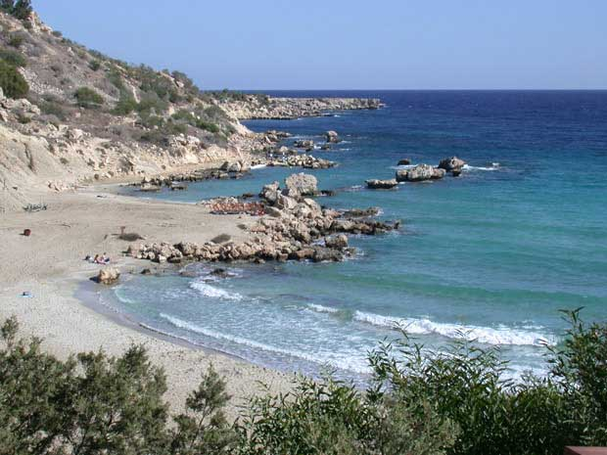
TULONG SA PAG-AARAL #24
…SULYAP SA PAGLALAKBAY NI PABLO
OSEANONG ATLANTKO
A.D. 46-48
EUROPA
ASIA
ANG DAGAT SA CHITTIM
ROMA•
Macedonia
•Pisidian Antioquia
•
•Efeso
APRICA
Atenas
Mga Gawa 13-14
•Siryan Antioquia
DAGAT
MEDITERANEO
#1.“Mga Katuturan: Laboratoryo”
•Jerusalem
Mga Katuturan: sumamba ng mga dios-dios; gumawa ng mga milagro; binato si Pablo; mahirap na trabaho; mga naitanim na Iglesia; bumalik sa dating daan.
ARABYA
42
14
© 2006 TBBMI
9.65.08.
Notes:
With these ideas in mind…and with Study Help #24…let’s go with Paul on his JOURNEYS AT A GLANCE. First…the main locations of the dramatic action facing Paul and his little party…
//// Here is Jerusalem…
//// SYRIAN Antioch…
//// PISIDIAN Antioch…(there were many ancient Antiochs!)…
//// Ephesus…
//// Macedonia…(Remember Alexander’s birthplace?)…
//// Athens…
//// and the capital city of the world of his day…ROME, at the center of Empire.
//// So…Trip #1: Call it the HOOK…or A LABORATORY on Study Help #24…
//// Recounted in some detail in Acts 13 and 14.
//// Here’s a Cyprian beach typical of those Paul and his party would have moved across.
//// On your map trace out his route similar to A HOOK SHAPE that moves from SYRIAN ANTIOCH through the island of Cyprus and on into central Turkey.
//// Significance of this trip: IT WAS A LEARNING LABORATORY! No one had done this before. Along the way they were worshipped as GODS…because the people had never seen anything like this…these strangers were going about working miracles. But in spite of those good works, Paul was STONED and almost died. The party must have quickly recognized that mission would become a very difficult work indeed. But along the way many new churches were planted. What kept them going? Faith in all they had seen and experienced in the development of their own Christian spirit and intellect. Their travel route began at Syrian Antioch – follow your hook – into today’s central Turkey…
//// …then they turned around and returned to Syrian Antioch by the same route, there to report the results of their journey to the church.
//// LENGTH OF THIS TRIP: PROBABLY ABOUT TWO YEARS
IN THE LAST HALF OF THE A.D. 40s.

Slide 43
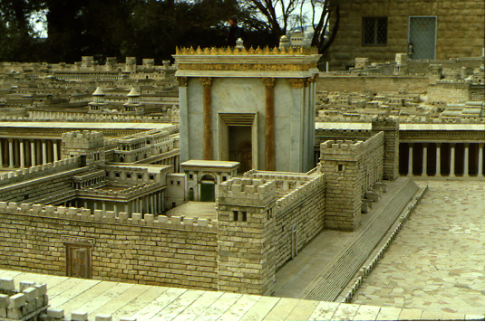
Mga Gawa 15:1:
Kinakailangan ba na ang mga Hentil ay magiging Hudyo, at tanggapin ang mga batas at gawin ang mga seremonya,bago sya maging isang Kristyano?
A.D.49
OSEANONG ATLANTKO
EUROPA
Tanging ang Grasya lamang
ASYA
ROMA•
Macedonia
•Pisidian Antioquia
•
•Efeso
APRICA
Atenas
Mga Gawa 15
•Siryan Antioquia
DAGAT
MEDITERANEO
1(--)2“Ang Konseho sa Jerusalem”
•Jerusalem
Ang problema ay lutas na: GRASYA, at hindi BATAS!
ARABYA
43
14
© 2006 TBBMI
9.65.08.
Notes:
With these ideas in mind…and with Study Help #24…let’s go with Paul on his JOURNEYS AT A GLANCE. First…the main locations of the dramatic action facing Paul and his little party…
//// Here is Jerusalem…
//// SYRIAN Antioch…
//// PISIDIAN Antioch…(there were many ancient Antiochs!)…
//// Ephesus…
//// Macedonia…(Remember Alexander’s birthplace?)…
//// Athens…
//// and the capital city of the world of his day…ROME, at the center of Empire.
//// So…Trip #1: Call it the HOOK…or A LABORATORY on Study Help #24…
//// Recounted in some detail in Acts 13 and 14.
//// Here’s a Cyprian beach typical of those Paul and his party would have moved across.
//// On your map trace out his route similar to A HOOK SHAPE that moves from SYRIAN ANTIOCH through the island of Cyprus and on into central Turkey.
//// Significance of this trip: IT WAS A LEARNING LABORATORY! No one had done this before. Along the way they were worshipped as GODS…because the people had never seen anything like this…these strangers were going about working miracles. But in spite of those good works, Paul was STONED and almost died. The party must have quickly recognized that mission would become a very difficult work indeed. But along the way many new churches were planted. What kept them going? Faith in all they had seen and experienced in the development of their own Christian spirit and intellect. Their travel route began at Syrian Antioch – follow your hook – into today’s central Turkey…
//// …then they turned around and returned to Syrian Antioch by the same route, there to report the results of their journey to the church.
//// LENGTH OF THIS TRIP: PROBABLY ABOUT TWO YEARS
IN THE LAST HALF OF THE A.D. 40s.

Slide 44
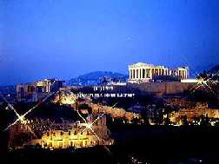
A.D. 49-52
OSEANONG ATLANTKO
EUROPA
Sinaunang panahon sa Atenas
ASYA
ROMA•
Macedonia
•Pisidian Antioquia
•
•Efeso
APRICA
Atenas
Mga Gawa 15-18
•Siryan Antioquia
DAGAT
MEDITERANEO
2.“Ang Tulos sa Europa”
•Jerusalem
Mga katuturan: maraming Iglesiya ang naitanim; ang anyaya sa Macedonia,at sa Atenas, ang “di kilalang dios;” Mars Hill;ang matagal na pagtira sa Corinto.
ARABYA
44
14
© 2006 TBBMI
9.65.08.
Notes:
With these ideas in mind…and with Study Help #24…let’s go with Paul on his JOURNEYS AT A GLANCE. First…the main locations of the dramatic action facing Paul and his little party…
//// Here is Jerusalem…
//// SYRIAN Antioch…
//// PISIDIAN Antioch…(there were many ancient Antiochs!)…
//// Ephesus…
//// Macedonia…(Remember Alexander’s birthplace?)…
//// Athens…
//// and the capital city of the world of his day…ROME, at the center of Empire.
//// So…Trip #1: Call it the HOOK…or A LABORATORY on Study Help #24…
//// Recounted in some detail in Acts 13 and 14.
//// Here’s a Cyprian beach typical of those Paul and his party would have moved across.
//// On your map trace out his route similar to A HOOK SHAPE that moves from SYRIAN ANTIOCH through the island of Cyprus and on into central Turkey.
//// Significance of this trip: IT WAS A LEARNING LABORATORY! No one had done this before. Along the way they were worshipped as GODS…because the people had never seen anything like this…these strangers were going about working miracles. But in spite of those good works, Paul was STONED and almost died. The party must have quickly recognized that mission would become a very difficult work indeed. But along the way many new churches were planted. What kept them going? Faith in all they had seen and experienced in the development of their own Christian spirit and intellect. Their travel route began at Syrian Antioch – follow your hook – into today’s central Turkey…
//// …then they turned around and returned to Syrian Antioch by the same route, there to report the results of their journey to the church.
//// LENGTH OF THIS TRIP: PROBABLY ABOUT TWO YEARS
IN THE LAST HALF OF THE A.D. 40s.

Slide 45
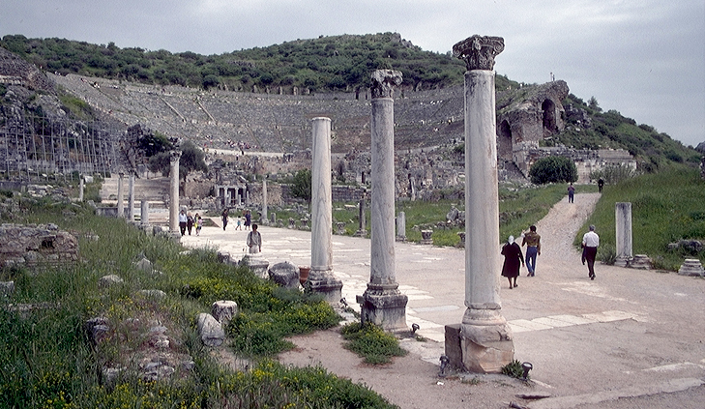
OSEANONG ATLANTKO
A.D. 53-57
EUROPA
Sinaunang Panahon sa Efeso
ASYA
ROMA•
Macedonia
•Pisidian Antioquia
•
•Efeso
APRICA
Atenas
Mga Gawa 18-20
•Siryan Antioquia
DAGAT
MEDITERANEO
3.“Ang Tulos sa ASYA”
•Jerusalem
Mga katuturan: mahabang panahon ang iginugol sa Iglesiya sa Efeso; isang binata ang nabuhay; naisulat ang mga mahalagang sulat; kaguluhan laban sa mga taga Efeso sa amphitheatro.
ARABYA
45
14
© 2006 TBBMI
9.65.08.
Notes:
With these ideas in mind…and with Study Help #24…let’s go with Paul on his JOURNEYS AT A GLANCE. First…the main locations of the dramatic action facing Paul and his little party…
//// Here is Jerusalem…
//// SYRIAN Antioch…
//// PISIDIAN Antioch…(there were many ancient Antiochs!)…
//// Ephesus…
//// Macedonia…(Remember Alexander’s birthplace?)…
//// Athens…
//// and the capital city of the world of his day…ROME, at the center of Empire.
//// So…Trip #1: Call it the HOOK…or A LABORATORY on Study Help #24…
//// Recounted in some detail in Acts 13 and 14.
//// Here’s a Cyprian beach typical of those Paul and his party would have moved across.
//// On your map trace out his route similar to A HOOK SHAPE that moves from SYRIAN ANTIOCH through the island of Cyprus and on into central Turkey.
//// Significance of this trip: IT WAS A LEARNING LABORATORY! No one had done this before. Along the way they were worshipped as GODS…because the people had never seen anything like this…these strangers were going about working miracles. But in spite of those good works, Paul was STONED and almost died. The party must have quickly recognized that mission would become a very difficult work indeed. But along the way many new churches were planted. What kept them going? Faith in all they had seen and experienced in the development of their own Christian spirit and intellect. Their travel route began at Syrian Antioch – follow your hook – into today’s central Turkey…
//// …then they turned around and returned to Syrian Antioch by the same route, there to report the results of their journey to the church.
//// LENGTH OF THIS TRIP: PROBABLY ABOUT TWO YEARS
IN THE LAST HALF OF THE A.D. 40s.

Slide 46
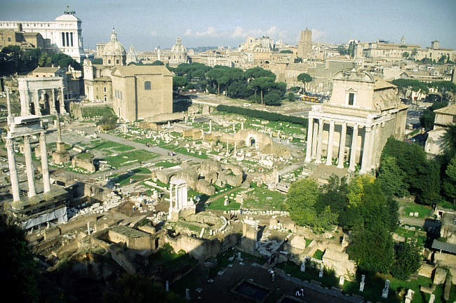
A.D. 59-62
OSEANONG ATLANTKO
EUROPA
Sinaunang pinagtitiponan sa Roma
ASYA
ROMA•
Macedonia
•Pisidian Antioquia
•
•Efeso
APRICA
Atenas
Mga Gawa 18-20
•Siryan Antioquia
DAGAT
MEDITERANEO
4.“Sa Roma at Magtamo”
•Jerusalem
Mga katuturan: bilang priso, ipinadala sa Roma;Ang impluwensiya ng Kristyanismo sa bilanguan at sa bahay ni Cesar; mga mahalagang sulat; “ ilaban ang magandang laban, ipagpatuloy ang pananampalataya!”
ARABYA
46
14
© 2006 TBBMI
9.65.08.
Notes:
With these ideas in mind…and with Study Help #24…let’s go with Paul on his JOURNEYS AT A GLANCE. First…the main locations of the dramatic action facing Paul and his little party…
//// Here is Jerusalem…
//// SYRIAN Antioch…
//// PISIDIAN Antioch…(there were many ancient Antiochs!)…
//// Ephesus…
//// Macedonia…(Remember Alexander’s birthplace?)…
//// Athens…
//// and the capital city of the world of his day…ROME, at the center of Empire.
//// So…Trip #1: Call it the HOOK…or A LABORATORY on Study Help #24…
//// Recounted in some detail in Acts 13 and 14.
//// Here’s a Cyprian beach typical of those Paul and his party would have moved across.
//// On your map trace out his route similar to A HOOK SHAPE that moves from SYRIAN ANTIOCH through the island of Cyprus and on into central Turkey.
//// Significance of this trip: IT WAS A LEARNING LABORATORY! No one had done this before. Along the way they were worshipped as GODS…because the people had never seen anything like this…these strangers were going about working miracles. But in spite of those good works, Paul was STONED and almost died. The party must have quickly recognized that mission would become a very difficult work indeed. But along the way many new churches were planted. What kept them going? Faith in all they had seen and experienced in the development of their own Christian spirit and intellect. Their travel route began at Syrian Antioch – follow your hook – into today’s central Turkey…
//// …then they turned around and returned to Syrian Antioch by the same route, there to report the results of their journey to the church.
//// LENGTH OF THIS TRIP: PROBABLY ABOUT TWO YEARS
IN THE LAST HALF OF THE A.D. 40s.

Slide 47
TULONG SA PAG-AARAL #36
SULYAP SA PAGLALAKBAY NI
PABLO BILANG MISYONERO
OSEANONG ATLANTKO
#1.“ANG KAWIL: LABORATORYO”
(Ang 21 na mga Aklat)‏
PANSAMANTALA: ANG KONSEHO SA JERUSALEM
ANG MGA
ISYU SA
IGLESIYA
EUROPA
ASYA
ROMA•
Macedonia
#2.ANG TULOS SA EUROPA
Ang mga
Sulat
•Pisidian Antioquia
•
•Efeso
APRICA
Atenas
•Siryan Antioquia
DAGAT
MEDITERANEO
#3.ANG TULOS SA ASYA
•Jerusalem
#4. SA ROMA AT MAGTAMO
ARABYA
47
14
© 2006 TBBMI
9.65.08.
Notes:
With these ideas in mind…and with Study Help #24…let’s go with Paul on his JOURNEYS AT A GLANCE. First…the main locations of the dramatic action facing Paul and his little party…
//// Here is Jerusalem…
//// SYRIAN Antioch…
//// PISIDIAN Antioch…(there were many ancient Antiochs!)…
//// Ephesus…
//// Macedonia…(Remember Alexander’s birthplace?)…
//// Athens…
//// and the capital city of the world of his day…ROME, at the center of Empire.
//// So…Trip #1: Call it the HOOK…or A LABORATORY on Study Help #24…
//// Recounted in some detail in Acts 13 and 14.
//// Here’s a Cyprian beach typical of those Paul and his party would have moved across.
//// On your map trace out his route similar to A HOOK SHAPE that moves from SYRIAN ANTIOCH through the island of Cyprus and on into central Turkey.
//// Significance of this trip: IT WAS A LEARNING LABORATORY! No one had done this before. Along the way they were worshipped as GODS…because the people had never seen anything like this…these strangers were going about working miracles. But in spite of those good works, Paul was STONED and almost died. The party must have quickly recognized that mission would become a very difficult work indeed. But along the way many new churches were planted. What kept them going? Faith in all they had seen and experienced in the development of their own Christian spirit and intellect. Their travel route began at Syrian Antioch – follow your hook – into today’s central Turkey…
//// …then they turned around and returned to Syrian Antioch by the same route, there to report the results of their journey to the church.
//// LENGTH OF THIS TRIP: PROBABLY ABOUT TWO YEARS
IN THE LAST HALF OF THE A.D. 40s.

Slide 48
( Ang 21 na mga Aklat)‏
ANG MGA ISYU
SA IGLESIA
ANG MGA KALATAS: Sulat galing kay Pablo
Mga Taon sa Pagsulat:
A.D. 50s - 90s
ANG MGA KALATAS
Ito ay tungkol sa hindi pa nasiyasat na mga isyu na nangangailangan ng bago at mahalagang pagtuturo sa pamumuno ng mga bagong organismo ...
Ang EKLESIYA,
Ang IGLESIYA.
Marami sa mga Sulat ay kay Pablo …at ang iba ay galing sa mga “Ibang Manunulat.”
Mga Sulat
galing
sa Iba
48
3
Notes:
So the New Testament continues to come together in a collection of works called Epistles. Actually we have 21 very personal letters…
//// ….concerning generally unexplored issues requiring new and crucial instruction in leadership of that new organism, the ECCLESIA, the called-out ones, the CHURCH.
//// There are two large groups of these letters. Those from the Apostle Paul…and the letters from “The Others,” sometimes called the General Epistles.
//// These letters were written across the five decades from the A.D. 50s to the 90s..

Slide 49
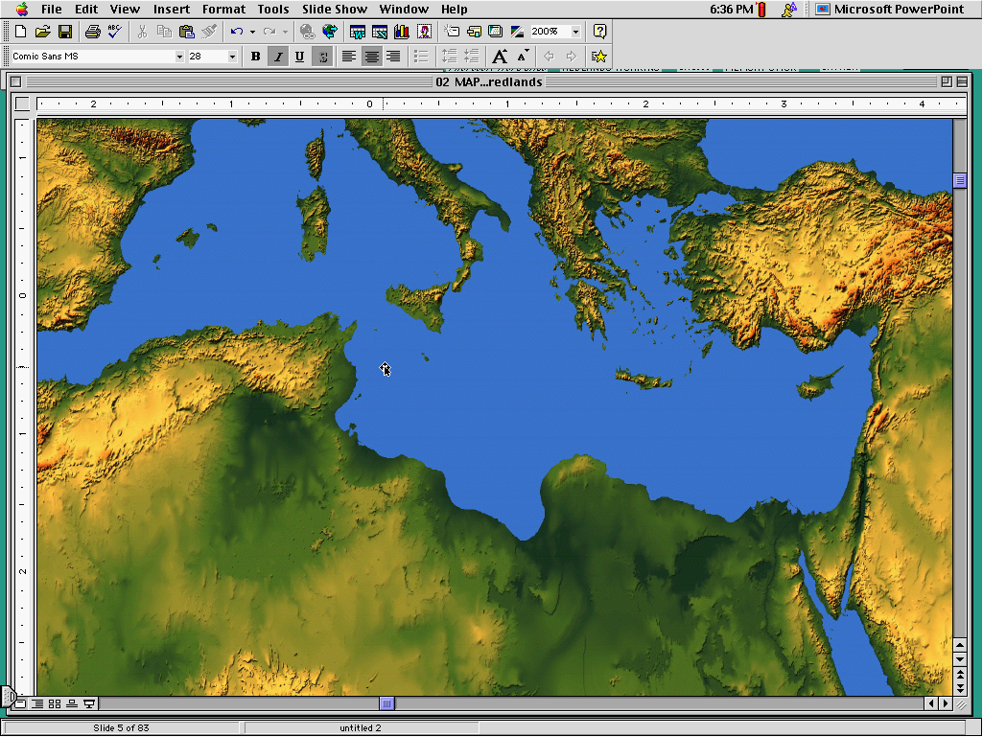
ANG PAGLAGANAP NG UNANG IGLESIYA
REPRESENTATIONAL LOCATIONS ONLY
9.65.08.
©2006 TBBMI
49
Notes:
[ON MED MAP: AUTO INSERTION OF 31 DOTS INDICATING NEWLY PLANTED CHURCHES –– REPRESENTATIVE ONLY]
As a means of wide communication, these circular letters were written to the new churches all across the Mediterranean Basin-- from Palestine to today’s Italy, Greece, Turkey and Crete. They dealt –– then and now ––with all matters imaginable of life and living among members of the many churches springing up throughout the region.

Slide 50
Ang mga Kalatas ang siyang naging gabay ng unang Iglesiya sa mga pangunahing mga prinsipyo …
• Sa organisasyon, sa operasyon, at sa pagpapalawak
• Ang Buhay bilang Iglesiya
• Ang Buhay bilang Pamilya
• Ang Buhay ng mga kalalakihan at kababaihan sa Iglesiya
• Ang Buhay kasama ang Banal na Ispiritu
• Ang Katuparan ng “Great Commission”
9.65.08.
6
©2006 TBBMI
50
Notes:
They provided the early church with its foundational principles of
//// organization, operation and expansion…
//// for life in the church,
//// for life in the family,
//// for life among the men and women of the church, and most importantly,
//// for an ever-expanding personal life in the Spirit while directing
//// efforts of the new Church toward accomplishment of The Great Commission.

Slide 51
( Ang 21 na mga Aklat)‏
ANG MGA ISYU
SA IGLESIA
ANG MGA KALATAS: Sulat galing kay Pablo
At ngayon, ang importanteng tanong ay:
Saan ito makikita?
Mga Sulat
galing
sa Iba
Letters from
The Others
Tulong sa Pag-aaral # 20
48
3
Notes:
So the New Testament continues to come together in a collection of works called Epistles. Actually we have 21 very personal letters…
//// ….concerning generally unexplored issues requiring new and crucial instruction in leadership of that new organism, the ECCLESIA, the called-out ones, the CHURCH.
//// There are two large groups of these letters. Those from the Apostle Paul…and the letters from “The Others,” sometimes called the General Epistles.
//// These letters were written across the five decades from the A.D. 50s to the 90s..

Slide 52
( Ang 21 na mga Aklat)‏
ANG MGA ISYU
SA IGLESIA
ANG MGA KALATAS: Sulat galing kay Pablo
Mga Sulat
ni Pablo
“Ilan sa mga isyu sa
Roma ay
Kapareha sa 2 Corinto.”
}
Roma
1 Corinto
2 Corinto
ANG KANYANG MAHALAGANG ARAL NA ITINURO SA UNANG IGLESIYA
Roma
1 Corinto
2 Corinto
Letters from
The Others
48
3
Notes:
So the New Testament continues to come together in a collection of works called Epistles. Actually we have 21 very personal letters…
//// ….concerning generally unexplored issues requiring new and crucial instruction in leadership of that new organism, the ECCLESIA, the called-out ones, the CHURCH.
//// There are two large groups of these letters. Those from the Apostle Paul…and the letters from “The Others,” sometimes called the General Epistles.
//// These letters were written across the five decades from the A.D. 50s to the 90s..

Slide 53
( Ang 21 na mga Aklat)‏
ANG MGA ISYU
SA IGLESIA
ANG MGA KALATAS: Sulat galing kay Pablo
Mga Sulat
ni Pablo
“Ilan sa mga isyu sa
Roma ay
Kapareha sa 2 Corinto.”
Roma
1 Corinto
2 Corinto
Galacia
Efeso
Filipo
Colossas
}
ANG KANYANG MAHALAGANG ARAL NA ITINURO SA UNANG IGLESIYA
“Kumakain ang Hentil ng karneng baboy.”
Galacia
Efeso
Filipo
Colossas
Letters from
The Others
48
3
Notes:
So the New Testament continues to come together in a collection of works called Epistles. Actually we have 21 very personal letters…
//// ….concerning generally unexplored issues requiring new and crucial instruction in leadership of that new organism, the ECCLESIA, the called-out ones, the CHURCH.
//// There are two large groups of these letters. Those from the Apostle Paul…and the letters from “The Others,” sometimes called the General Epistles.
//// These letters were written across the five decades from the A.D. 50s to the 90s..

Slide 54
( Ang 21 na mga Aklat)‏
ANG MGA ISYU
SA IGLESIA
ANG MGA KALATAS: Sulat galing kay Pablo
Mga Sulat
ni Pablo
“Ilan sa mga isyu sa
Roma ay
Kapareha sa 2 Corinto.”
Roma
1 Corinto
2 Corinto
Galacia
Efeso
Filipo
Colossas
ANG KANYANG MAHALAGANG ARAL NA ITINURO SA UNANG IGLESIYA
“Kumakain ang Hentil ng karneng baboy.”
1 Tesaloica
2 Tesalonica
1 Santiago
2 Santiago
Titus
}
Ang daing ng tesorero ng
Iglesiya:
“May makukunat magbigay.”
1 Tesalonica
2 Tesalonica
1 Santiago
2 Santiago
Titus
Letters from
The Others
48
3
Notes:
So the New Testament continues to come together in a collection of works called Epistles. Actually we have 21 very personal letters…
//// ….concerning generally unexplored issues requiring new and crucial instruction in leadership of that new organism, the ECCLESIA, the called-out ones, the CHURCH.
//// There are two large groups of these letters. Those from the Apostle Paul…and the letters from “The Others,” sometimes called the General Epistles.
//// These letters were written across the five decades from the A.D. 50s to the 90s..

Slide 55
( Ang 21 na mga Aklat)‏
ANG MGA ISYU
SA IGLESIA
ANG MGA KALATAS: Sulat galing kay Pablo
Mga Sulat
ni Pablo
“Ilan sa mga isyu sa
Roma ay
Kapareha sa 2 Corinto.”
Roma
1 Corinto
2 Corinto
Galacia
Efeso
Filipo
Colossas
ANG KANYANG MAHALAGANG ARAL NA ITINURO SA UNANG IGLESIYA
“Kumakain ang Hentil ng karneng baboy.”
1 Tesaloica
2 Tesalonica
1 Santiago
2 Santiago
Titus
Ang daing ng tesorero ng
Iglesiya:
“May makukunat magbigay.”
}
Filemon
“Ang kaposang pakiusap in Pablo.”
Letters from
The Others
Filemon
48
3
Notes:
So the New Testament continues to come together in a collection of works called Epistles. Actually we have 21 very personal letters…
//// ….concerning generally unexplored issues requiring new and crucial instruction in leadership of that new organism, the ECCLESIA, the called-out ones, the CHURCH.
//// There are two large groups of these letters. Those from the Apostle Paul…and the letters from “The Others,” sometimes called the General Epistles.
//// These letters were written across the five decades from the A.D. 50s to the 90s..

Slide 56
( Ang 21 na mga Aklat)‏
ANG MGA ISYU
SA IGLESIA
ANG MGA KALATAS: Sulat galing kay Pablo
Ang mga Sulat
ni Pablo sa iksaktong hanay...
Mga Sulat
ni Pablo
Roma
1 Corinto
2 Corinto
Galacia
Efeso
Filipo
Colossas
ANG KANYANG MAHALAGANG ARAL NA ITINURO SA UNANG IGLESIYA
1 Tesaloica
2 Tesalonica
1 Santiago
2 Santiago
Titus
Filemon
Letters from
The Others
48
3
Notes:
So the New Testament continues to come together in a collection of works called Epistles. Actually we have 21 very personal letters…
//// ….concerning generally unexplored issues requiring new and crucial instruction in leadership of that new organism, the ECCLESIA, the called-out ones, the CHURCH.
//// There are two large groups of these letters. Those from the Apostle Paul…and the letters from “The Others,” sometimes called the General Epistles.
//// These letters were written across the five decades from the A.D. 50s to the 90s..

Slide 57
TULONG SA PAG-AARAL #25
ANG DALAWANG PINAKAMAHALAGANG TEOLOHIKONG KATOTOHANAN NA IPINAHAYAG NI PABLO
Ang pinaka-pundasyon ng Kristianismong Kaisipan at kaugalian
PAGBIBIGAY-KATARUNGAN -- kalayaan sa pagiging makasalanan…at maging BANAL
( KAGYAT AT “ISANG BESES” NA PANGYAYARI!)‏
Gen 15:6 At sumampalataya siya sa Panginoon; at ito'y ibinilang na katuwiran sa kaniya.
PAGPAPAKABANAL -- ilaan para sa banal na paggamit.
(ANG PATULOY AT MAKABULUHANG PROSESO!)‏
1CoR 1:2 Sa iglesia ng Dios na nasa Corinto, sa makatuwid baga'y sa mga pinapagingbanal kay Cristo Jesus, na tinawag na mangagbanal, na kasama ng lahat ng mga nagsisitawag sa bawa't dako, sa pangalan ng ating Panginoong Jesucristo, na kanila at ating Panginoon:--
2 Corinto 5:17 at Roma 5:1-4
57
8
Notes:
Before we leave Paul’s part of the Epistles collection, move to Study Help #25…where…
//// …we’ll indicate two anchor points in all that he thought, taught, and wrote. Two of Paul’s key theological truths are significant because they are the very foundation of Christian thought and practice.
//// First…the word JUSTIFICATION…which means to release from the guilt of sin and to make RIGHTEOUS…
//// The point being: JUSTIFICATION is an instant “one-time” event.
//// JUSTIFICATION takes us straight back to Abraham and his encounter with God in Genesis 15:6. The Word reports that “Abram believed the Lord and he [God] credited it to him as righteousness.”
//// And then…SANCTIFICATION…that word meaning “to set apart for some sacred use.”
//// Unlike JUSTIFICATION… SANCTIFICATION is a CONTINUING maturing process…growing daily, maturing steadily!
//// In 1 Corinthians 1:2…Paul wrote: “To the church of God in Corinth, to those sanctified in Christ Jesus and called to be holy, together with all those everywhere who call on the name of our Lord Jesus Christ…”
Additional references to sanctification are found in 2 Corinthians 5:17 and Romans 5: 1-4.
//// JUSTIFICATION…A ONE-TIME EVENT… SANCTIFICATION… A CONTINUING MATURING PROCESS

Slide 58
( Ang 21 na mga Aklat)‏
ANG MGA ISYU
SA IGLESIA
ANG MGA KALATAS: Sulat galing kay Pablo
MGA SULAT GALING SA “IBANG MANUNULAT”
Hebreo
Santiago
1 Pedro
2 Pedro
1 Juan
2 Juan
3 Juan
Judas
Roma
1 Corinto
2 Corinto
Galacia
Efeso
Filipo
Colossas
1 Tesaloica
2 Tesalonica
1 Santiago
2 Santiago
Titus
Filemon
Ang pangkalahatang Kalatas
(hindi galing kay Pablo)
Letters from
The Others
Mga Sulat
Galing sa Iba
“Sa Telebisyon ng Jerusalem,
Ang mga HEBREO tagahatid balita...
SANTIAGO,
PEDRO
JUAN,
at
JUDAS.”
Hebreo
Santiago
1 Pedro
2 Pedro
1 Juan
2 Juan
3 Juan
Judas
48
3
Notes:
So the New Testament continues to come together in a collection of works called Epistles. Actually we have 21 very personal letters…
//// ….concerning generally unexplored issues requiring new and crucial instruction in leadership of that new organism, the ECCLESIA, the called-out ones, the CHURCH.
//// There are two large groups of these letters. Those from the Apostle Paul…and the letters from “The Others,” sometimes called the General Epistles.
//// These letters were written across the five decades from the A.D. 50s to the 90s..

Slide 59
( Ang 21 na mga Aklat)‏
ANG MGA ISYU
SA IGLESIA
ANG MGA KALATAS: Sulat galing kay Pablo
“Ilan sa mga isyu sa
Roma ay
Kapareha sa 2 Corinto.”
Roma
1 Corinto
2 Corinto
Ang Kompletong Koleksyon ng mga Kalatas (Sulat) sa Bagong Tipan
Galacia
Efeso
Filipo
Colossas
“Kumakain ang Hentil ng karneng baboy.”
1 Tesaloica
2 Tesalonica
1 Santiago
2 Santiago
Titus
Ang daing ng tesorero ng
Iglesiya:
“May makukunat magbigay.”
Filemon
“Ang kaposang pakiusap in Pablo.”
Letters from
The Others
Mga Sulat
Galing sa Iba
“Sa Telebisyon ng Jerusalem,
Ang mga HEBREO tagahatid balita...
SANTIAGO,
PEDRO
JUAN,
at
JUDAS.”
Hebreo
Santiago
1 Pedro
2 Pedro
1 Juan
2 Juan
3 Juan
Judas
48
3
Notes:
So the New Testament continues to come together in a collection of works called Epistles. Actually we have 21 very personal letters…
//// ….concerning generally unexplored issues requiring new and crucial instruction in leadership of that new organism, the ECCLESIA, the called-out ones, the CHURCH.
//// There are two large groups of these letters. Those from the Apostle Paul…and the letters from “The Others,” sometimes called the General Epistles.
//// These letters were written across the five decades from the A.D. 50s to the 90s..

Slide 60
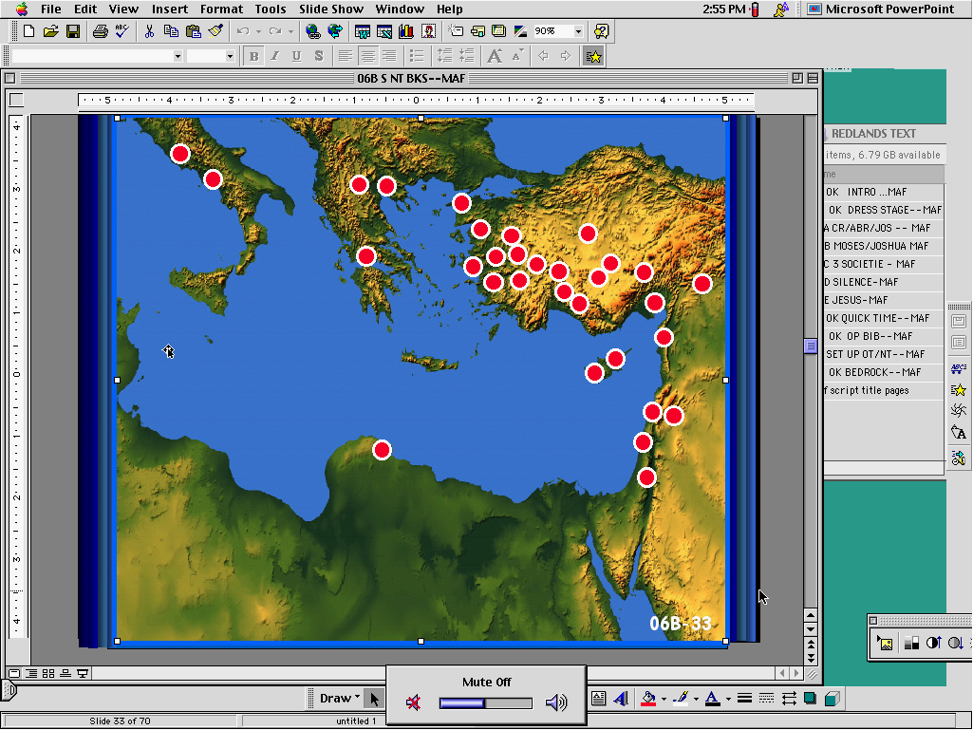
( Ang 21 na mga Aklat)‏
ANG MGA ISYU
SA IGLESIA
ANG MGA KALATAS: Sulat galing kay Pablo
Roma
1 Corinto
2 Corinto
Ang Kompletong Koleksyon ng mga Kalatas (Sulat) sa Bagong Tipan
Galacia
Efeso
Filipo
Colossas
1 Tesaloica
2 Tesalonica
1 Santiago
2 Santiago
Titus
Mga Pulibotsulat para sa Unang Iglesiya
Filemon
Mga Sulat
Galing sa Iba
Hebreo
Santiago
1 Pedro
2 Pedro
1 Juan
2 Juan
3 Juan
Judas
60
Notes:
These are the letters that have come down to us through history. There may very well have been others, but these are the ones God saw fit to preserve for us today.

Slide 61
ANO KAYA ANG MGA SAPATAHA SA LIKOD NG MGA SULAT?
BAKIT KAYA SILA ISINULAT…?
61
1
Notes:
Before we leave the Epistles, we should answer a question often asked of Bible teachers. First…what about the ideas behind the letters?
//// In other words…why were they written in the first place?

Slide 62
GABAY SA PAG-AARAL #26
ANG MGA “KALATAS” AY MGA “SULAT”…
…NA NAHAHATI SA DALAWANG BAHAGI
ITO AY ANG MGA SULAT NI PABLO
ANG MGA KALATAS
NI PABLO
ANG PANGKALAHATANG KALATAS
ITO AY MGA SULAT GALING SA “IBANG MANUNULAT”
62
6
Notes:
With Study Help 26 to help put this together….
//// As earlier…the epistles are actually letters…
//// …in two sections.
//// …the so-called PAULINE EPISTLES…
//// …and the GENERAL EPISTLES…
//// OR…the letters that Paul wrote…
//// and the letters from “the others.”

Slide 63
UNA: ANG MGA SULAT GALING KAY PABLO
ROMAN
1 COR
2 COR
GALACIA
EFESO
FILIPO
COLOSAS
PAGBIBIGAY-KATARUNGAN SA PAMAMAGITAN NG PANANALIG
KRISTYANONG ASAL SA IGLESYA
ANG PAGIGING TUNAY NA APOSTOL NI PABLO
ANG KAPANGYARIHAN NG GRASYA
ANG KATAYUAN AT URI NG PAMUMUHAY NG ISANG NANINIWALA
SI HESU-KRISTO AY ANG ATING KAGALAKAN
SI HESU-KRISTO: ANG ATING LUBOS NA KASAPATAN
1:17
1:2
12:9
3:2
1:3
4:4
2:10
1 CORINTO 1:2
Sa iglesia ng Dios na nasa Corinto, sa makatuwid baga'y sa mga pinapagingbanal kay Cristo Jesus, na tinawag na mangagbanal, na kasama ng lahat ng mga nagsisitawag sa bawa't dako, sa pangalan ng ating Panginoong Jesucristo, na kanila at ating Panginoon.
2 CORINTO 12:9
At siya'y nagsabi sa akin, Ang aking biyaya ay sapat na sa iyo: sapagka't ang aking kapangyarihan ay nagiging sakdal sa kahinaan. Kaya't bagkus akong magmamapuri na may malaking galak sa aking kahinaan upang manahan nawa sa akin ang kapangyarihan ni Cristo.
ROMA 1:17
Sapagka't dito ang katuwiran ng Dios ay nahahayag mula sa pananampalataya hanggang sa pananampalataya: gaya ng nasusulat, Nguni't ang ganap ay mabubuhay sa pamamagitan ng pananampalataya.
COLOSAS 2:10
… At sa kaniya kayo'y napuspus na siyang pangulo ng lahat na pamunuan at kapangyarihan.
FILIPO 4:4
Mangagalak kayong lagi sa Panginoon: muli kong sasabihin, Mangagalak kayo!
EFESO 1:3
Purihin nawa ang Dios at Ama ng ating Panginoong Jesucristo, na siyang nagpala sa atin ng bawa't pagpapalang ukol sa espiritu sa sangkalangitan kay Cristo:
GALACIA 3:2 Ito lamang ang ibig kong maalaman sa inyo, Tinanggap baga ninyo ang Espiritu sa pamamagitan ng mga gawang ayon sa kautusan, o sa pamamagitan ng pakikinig ng tungkol sa pananampalataya?
63
7
Notes:
First…the letters from Paul’s pen…giving just one main idea from each of those letters…there are certainly other ideas beyond these.
For instance…
+ + + + + +
//// ROMANS 1:17…Justification by FAITH…
“For in the gospel a righteousness from God is revealed, a righteousness that is by faith from first to last, just as it is written: ‘The righteous will live by faith.’” (NIV)
+ + + + + +
//// 1 CORINTHIANS 1:2…concerning Christian conduct in the church…
“To the church of God in Corinth, to those sanctified in Christ Jesus and called to be holy, together with all those everywhere who call on the name of our Lord Jesus Christ – their Lord and ours:” (NIV)
+ + + + + +
//// 2 CORINTHIANS 12:9….about the authenticity of Paul’s apostleship…
“But He said to me, ‘My grace is sufficient for you, for my power is made perfect in weakness.’ Therefore I will boast all the more gladly about my weaknesses, so that Christ’s power may rest on me.” (NIV)
+ + + + + +
//// GALATIANS 3:2…on the power of GRACE… “I would like to learn just one thing from you: Did you receive the Spirit by observing the law, or by believing what you heard?” (NIV)
+ + + + + +
//// EPHESIANS 1:3…about the position and walk of the believer…
“Praise be to the God and Father of our Lord Jesus Christ, who has blessed us in the heavenly realms with every spiritual blessing in Christ.” (NIV)
+ + + + + +
//// PHILIPPIANS 4:4…Jesus Christ our joy…
“Rejoice in the Lord always. I will say it again: Rejoice!”
+ + + + + +
//// COLOSSIANS 2:10…Jesus Christ: totally adequate…
“…and you have been given fullness in Christ, who is the head over every power and authority.” (NIV)
+ + + + + +

Slide 64
UNA: ANG MGA SULAT GALING KAY PABLO
ROMA
1 COR
2 COR
GALACIA
EFESO
FILIPO
COLOSSAS
KRISTYANONG ASAL SA IGLESYA
ANG PAGIGING TUNAY NA APOSTOL NI PABLO
ANG KATAYUAN AT URI NG PAMUMUHAY NG ISANG NANINIWALA
PAGBIBIGAY-KATARUNGAN SA PAMAMAGITAN NG PANANALIG
ANG KAPANGYARIHAN NG GRASYA
SI HESU-KRISTO AY ANG ATING KAGALAKAN
SI HESU-KRISTO: ANG ATING LUBOS NA KASAPATAN
1:17
1:2
12:9
3:2
1:3
4:4
2:10
1 TESALONICA
2 TESALONICA
1 SANTIAGO
2 SANTIAGO
TITUS
FILEMON
ANG PAGBABALIK NG PANGINOONG HESUS
ANG WASTONG TUNTUNIN NG IGLESYA
INGATAN ANG EBANGHELYO; IPANGARAL ITO
KAKAYAHAN NG MGA DYAKONO
ANG PAGTANGGAP NG MGA BAGO KAY KRISTO
ANG MGA PANGYAYARI SA HULING MGA ARAW
1:10
1:6
2:8
1:13
2:1-2
v.17-18
2 TESALONICA 1:6-7
Kung isang bagay na matuwid sa Dios na gantihin ng kapighatian ang mga pumipighati sa inyo, at kayong mga pinighati ay bigyang kasama namin ng kapahingahan sa pagpapakahayag ng Panginoong Jesus mula sa langit na kasama ang mga anghel ng kaniyang kapangyarihan na nasa nagniningas na apoy.
1 TESALONICA 1:10
..At upang hintayin ang kaniyang Anak na mula sa langit, na kaniyang ibinangon sa mga patay, si Jesus nga na nagligtas sa atin mula sa galit na darating.
TITUS 2:1-2
Nguni't magsalita ka ng mga bagay na nauukol sa aral na magaling Na ang matatandang lalake ay maging mapagpigil, mahusay, mahinahon ang pagiisip, magagaling sa pananampalataya, sa pagibig, sa pagtitiis.
FILEMON 1: 17-18
Kung ako nga ay inaari mong kasama, ay tanggapin mo siyang tila ako rin. Nguni't kung siya'y nagkasala sa iyo ng anoman, o may utang sa iyong anoman, ay ibilang mo sa akin;
1 SANTIAGO 2:8
Ibig ko ngang ang mga tao'y magsipanalangin sa bawa't dako, na iunat ang mga kamay na banal, na walang galit at pakikipagtalo.
2 SANTIAGO 1:13
Ingatan mo ang mga ulirang mga salitang magagaling na narinig mo sa akin, sa pananampalataya at pagibig na nasa kay Cristo Jesus.
63
7
Notes:
First…the letters from Paul’s pen…giving just one main idea from each of those letters…there are certainly other ideas beyond these.
For instance…
+ + + + + +
//// ROMANS 1:17…Justification by FAITH…
“For in the gospel a righteousness from God is revealed, a righteousness that is by faith from first to last, just as it is written: ‘The righteous will live by faith.’” (NIV)
+ + + + + +
//// 1 CORINTHIANS 1:2…concerning Christian conduct in the church…
“To the church of God in Corinth, to those sanctified in Christ Jesus and called to be holy, together with all those everywhere who call on the name of our Lord Jesus Christ – their Lord and ours:” (NIV)
+ + + + + +
//// 2 CORINTHIANS 12:9….about the authenticity of Paul’s apostleship…
“But He said to me, ‘My grace is sufficient for you, for my power is made perfect in weakness.’ Therefore I will boast all the more gladly about my weaknesses, so that Christ’s power may rest on me.” (NIV)
+ + + + + +
//// GALATIANS 3:2…on the power of GRACE… “I would like to learn just one thing from you: Did you receive the Spirit by observing the law, or by believing what you heard?” (NIV)
+ + + + + +
//// EPHESIANS 1:3…about the position and walk of the believer…
“Praise be to the God and Father of our Lord Jesus Christ, who has blessed us in the heavenly realms with every spiritual blessing in Christ.” (NIV)
+ + + + + +
//// PHILIPPIANS 4:4…Jesus Christ our joy…
“Rejoice in the Lord always. I will say it again: Rejoice!”
+ + + + + +
//// COLOSSIANS 2:10…Jesus Christ: totally adequate…
“…and you have been given fullness in Christ, who is the head over every power and authority.” (NIV)
+ + + + + +

Slide 65
UNA: ANG MGA SULAT GALING KAY PABLO
ROMA
1 COR
2 COR
GALACIA
EFESO
FILIPO
COLOSSAS
KRISTYANONG ASAL SA IGLESYA
ANG PAGIGING TUNAY NA APOSTOL NI PABLO
ANG KATAYUAN AT URI NG PAMUMUHAY NG ISANG NANINIWALA
PAGBIBIGAY-KATARUNGAN SA PAMAMAGITAN NG PANANALIG
ANG KAPANGYARIHAN NG GRASYA
SI HESU-KRISTO AY ANG ATING KAGALAKAN
SI HESU-KRISTO: ANG ATING LUBOS NA KASAPATAN
1 PEDRO 2:7
Sa inyo ngang nangananampalataya, siya'y mahalaga: datapuwa't sa hindi nangananampalataya, Ang batong itinakuwil ng nagsisipagtayo ng bahay Siyang naging pangulo sa panulok.
HEBREO 1:4
Na naging lalong mabuti kay sa mga anghel, palibhasa'y nagmana ng lalong marilag na pangalan kay sa kanila.
1 JUAN5:13
Ang mga bagay na ito ay isinulat ko sa inyo, upang inyong maalaman na kayo'y mayroong buhay na walang hanggan, sa makatuwid ay sa inyong nananampalataya sa pangalan ng Anak ng Dios.
3 JUAN vv. 4, 11
Wala nang dakilang kagalakan sa ganang akin na gaya nito, na marinig na ang aking mga anak ay nagsisilakad sa katotohanan…minamahal, huwag mong tularan ang masama, kundi ang mabuti. Ang gumagawa ng mabuti ay sa Dios: ang gumagawa ng masama ay hindi nakakita sa Dios.
2 PEDRO 2:1
Nguni't may nagsilitaw din naman sa bayan na mga bulaang propeta, na gaya naman sa inyo'y magkakaroon ng mga bulaang guro, na mangagpapasok sa lihim ng mga makakapahamak na mga hiduwang pananampalataya, na itatatuwa pati ang Panginoon na bumili sa kanila, na mangagtataglay sa kanilang sarili ng madaling pagkapahamak.
JUDAS vv. 20-21
Nguni't kayo, mga minamahal, papagtibayin ninyo ang inyong sarili sa inyong lubhang banal na pananampalataya, na manalangin sa Espiritu Santo, na magsipanatili kayo sa pagibig sa Dios, na inyong asahan ang awa ng ating Panginoong Jesucristo sa ikabubuhay na walang hanggan.
2 JUAN v.3
Sumaatin nawa ang biyaya, awa, at kapayapaang mula sa Dios Ama at kay Jesucristo, Anak ng Ama, sa katotohanan at sa pagibig.
SANTIAGO 2:26 Sapagka't kung paanong ang katawan na walang espiritu ay patay, ay gayon din ang pananampalataya na walang mga gawa ay patay.
1:17
1:2
12:9
3:2
1:3
4:4
2:10
1 TESALONICA
2 TESALONICA
1 SANTIAGO
2 SANTIAGO
TITUS
FILEMON
HEBREO
ANG PAGBABALIK NG PANGINOONG HESUS
ANG WASTONG TUNTUNIN NG IGLESYA
INGATAN ANG EBANGHELYO; IPANGARAL ITO
KAKAYAHAN NG MGA DYAKONO
ANG PAGTANGGAP NG MGA BAGO KAY KRISTO
SI HESUS-KRISTO: PINAMAKAMATAAS, KASAPATAN
ANG MGA PANGYAYARI SA HULING MGA ARAW
1:10
1:6
2:8
1:13
2:1-2
v.17-18
1:4
SANTIAGO
1 PEDRO
2 PEDRO
1 JUAN
2 JUAN
3 JUAN
JUDAS
MAKIKITA ANG PANANALIG SA ARAW-ARAW NA PAMUMUHAY
ANG PAMUMUHAY AT KATUNGKULAN NG KRISTYANO
MGA HUWAD NA MGA TITSER SA IGLESYA
ANG SIGURADONG KALIGTASAN; MAG-INGAT SA HUWAD NA TITSER
PAMUMUHAY AYON SA KAUTUSAN NI KRISTO
ANG APOSTOLIKONG AUTORIDAD NI JUAN
PANINDIGAN
ANG PANANALIG
2:26
2:7
2:1
5:13
v. 3
vs.4, 11
vs 20-21
PANGALAWA: MGA SULAT GALING SA “IBANG MANUNULAT”
7
63
Notes:
First…the letters from Paul’s pen…giving just one main idea from each of those letters…there are certainly other ideas beyond these.
For instance…
+ + + + + +
//// ROMANS 1:17…Justification by FAITH…
“For in the gospel a righteousness from God is revealed, a righteousness that is by faith from first to last, just as it is written: ‘The righteous will live by faith.’” (NIV)
+ + + + + +
//// 1 CORINTHIANS 1:2…concerning Christian conduct in the church…
“To the church of God in Corinth, to those sanctified in Christ Jesus and called to be holy, together with all those everywhere who call on the name of our Lord Jesus Christ – their Lord and ours:” (NIV)
+ + + + + +
//// 2 CORINTHIANS 12:9….about the authenticity of Paul’s apostleship…
“But He said to me, ‘My grace is sufficient for you, for my power is made perfect in weakness.’ Therefore I will boast all the more gladly about my weaknesses, so that Christ’s power may rest on me.” (NIV)
+ + + + + +
//// GALATIANS 3:2…on the power of GRACE… “I would like to learn just one thing from you: Did you receive the Spirit by observing the law, or by believing what you heard?” (NIV)
+ + + + + +
//// EPHESIANS 1:3…about the position and walk of the believer…
“Praise be to the God and Father of our Lord Jesus Christ, who has blessed us in the heavenly realms with every spiritual blessing in Christ.” (NIV)
+ + + + + +
//// PHILIPPIANS 4:4…Jesus Christ our joy…
“Rejoice in the Lord always. I will say it again: Rejoice!”
+ + + + + +
//// COLOSSIANS 2:10…Jesus Christ: totally adequate…
“…and you have been given fullness in Christ, who is the head over every power and authority.” (NIV)
+ + + + + +

Slide 66
UNA: ANG MGA SULAT GALING KAY PABLO
ROMA
1 COR
2 COR
GALACIA
EFESO
FILIPO
COLOSSAS
KRISTYANONG ASAL SA IGLESYA
ANG PAGIGING TUNAY NA APOSTOL NI PABLO
ANG KATAYUAN AT URI NG PAMUMUHAY NG ISANG NANINIWALA
PAGBIBIGAY-KATARUNGAN SA PAMAMAGITAN NG PANANALIG
ANG KAPANGYARIHAN NG GRASYA
SI HESU-KRISTO AY ANG ATING KAGALAKAN
SI HESU-KRISTO: ANG ATING LUBOS NA KASAPATAN
1:17
1:2
12:9
3:2
1:3
4:4
2:10
1 TESALONICA
2 TESALONICA
1 SANTIAGO
2 SANTIAGO
TITUS
FILEMON
HEBREO
ANG PAGBABALIK NG PANGINOONG HESUS
ANG WASTONG TUNTUNIN NG IGLESYA
INGATAN ANG EBANGHELYO; IPANGARAL ITO
KAKAYAHAN NG MGA DYAKONO
ANG PAGTANGGAP NG MGA BAGO KAY KRISTO
ANG MGA PANGYAYARI SA HULING MGA ARAW
SI HESUS-KRISTO: PINAMAKAMATAAS, KASAPATAN
1:10
1:6
2:8
1:13
2:1-2
v.17-18
1:4
SANTIAGO
1 PEDRO
2 PEDRO
1 JUAN
2 JUAN
3 JUAN
JUDAS
MAKIKITA ANG PANANALIG SA ARAW-ARAW NA PAMUMUHAY
ANG PAMUMUHAY AT KATUNGKULAN NG KRISTYANO
MGA HUWAD NA MGA TITSERS SA IGLESYA
ANG SIGURADONG KALIGTASAN; MAG-INGAT SA HUWAD NA TITSERS
PAMUMUHAY AYON SA KAUTUSAN NI KRISTO
ANG APOSTOLIKONG AWTORIDAD NI JUAN
PANINDIGAN
ANG PANANALIG
2:26
2:7
2:1
5:13
v. 3
vs.4, 11
vs 20-21
PANGALAWA: MGA SULAT GALING SA “IBANG MANUNULAT”
7
63
Notes:
First…the letters from Paul’s pen…giving just one main idea from each of those letters…there are certainly other ideas beyond these.
For instance…
+ + + + + +
//// ROMANS 1:17…Justification by FAITH…
“For in the gospel a righteousness from God is revealed, a righteousness that is by faith from first to last, just as it is written: ‘The righteous will live by faith.’” (NIV)
+ + + + + +
//// 1 CORINTHIANS 1:2…concerning Christian conduct in the church…
“To the church of God in Corinth, to those sanctified in Christ Jesus and called to be holy, together with all those everywhere who call on the name of our Lord Jesus Christ – their Lord and ours:” (NIV)
+ + + + + +
//// 2 CORINTHIANS 12:9….about the authenticity of Paul’s apostleship…
“But He said to me, ‘My grace is sufficient for you, for my power is made perfect in weakness.’ Therefore I will boast all the more gladly about my weaknesses, so that Christ’s power may rest on me.” (NIV)
+ + + + + +
//// GALATIANS 3:2…on the power of GRACE… “I would like to learn just one thing from you: Did you receive the Spirit by observing the law, or by believing what you heard?” (NIV)
+ + + + + +
//// EPHESIANS 1:3…about the position and walk of the believer…
“Praise be to the God and Father of our Lord Jesus Christ, who has blessed us in the heavenly realms with every spiritual blessing in Christ.” (NIV)
+ + + + + +
//// PHILIPPIANS 4:4…Jesus Christ our joy…
“Rejoice in the Lord always. I will say it again: Rejoice!”
+ + + + + +
//// COLOSSIANS 2:10…Jesus Christ: totally adequate…
“…and you have been given fullness in Christ, who is the head over every power and authority.” (NIV)
+ + + + + +

Slide 67
ROMA
EFESO
MACEDONIA
COLOSAS
FILEMON
2 CORINTO
FILIPO
1 TIMOTEO..
EFESO
HEBREO?
1 PEDRO
CORINTO
2 PEDRO
1 CORINTO
SIRYAN ANTIOQUIA
ROMA
2 TIMOTEO..
1 TESALONICA
TITUS
2 TESALONICA
1 JUAN
2 JUAN
GALACIA..
SAANG LUGAR SILA ISINULAT?
3 JUAN..
JERUSALEM
SANTIAGO
JUDAS..
9.65.08.
27
67
Notes:
Now…a final question about the letters…where were they written?
We know of six locations around the Mediterranean Sea from which they originated…
//// Jerusalem…
//// Syrian Antioch…
//// Ephesus…
//// Corinth…
//// the region of Macedonia…
//// and ancient Rome. Then…beginning in Jerusalem, the home of the mother church of infant Christianity…AND NOT NECESSARILY IN THE ORDER OF THEIR WRITING…
//// the letter of James…
//// and Jude.
Then north to Syrian Antioch…Paul’s residence for many years…
//// his letter to the Galatians.
Then from Ephesus…
//// First Corinthians…
//// Titus…
//// First John…
//// Second John…and
//// Third John.
Further east in Corinth, not far from Athens…Paul wrote
/// the great letter to the Romans…
//// First Thessalonians…and
//// Second Thessalonians…
Northward, somewhere in the region of Macedonia…
//// came Second Corinthians…
//// and Paul’s First letter to Timothy.
Rome was the site of many letters…such as
//// the one to the Ephesians…
//// to the Colossians…
//// the short letter to Philemon…
//// and Philippians.
Also from Rome…
//// First and…
//// Second Peter and
//// Second Timothy.
The last letter in this collection…
//// Hebrews…and its source could have been either the island of
Crete or from Rome -- because of evidences within the writings we can’t
be certain.

Slide 68
ROMA
EFESO
MACEDONIA
COLOSAS
FILEMON
2 CORINTO
FELIPO
1 TIMOTEO..
EFESO
HEBREO?
1 PEDRO
CORINTO
SIRYAN ANTIOQUIA
2 PEDRO
ROMA
1 CORINTO
2 TIMOTEO..
1 TESALONICA
TITUS
2 TESALONICA..
1 JUAN
2 JUAN
GALACIA..
Ang mga Pulibotsulat… patuloy na nag-uugnay!
3 JUAN..
JERUSALEM
SANTIAGO
JUDAS..
9.65.08.
©2006 TBBMI
68
Notes:
Now…if we again lay over that representation of the distant
churches…far and wide…we can begin to appreciate the importance of
Paul and The Others keeping in touch with the new untried
organizations throughout the Mediterranean Basin. Without these
“circular letters” it is doubtful that the church would have survived.
Nor would we have crucial instructions for carrying out the commission
of our Lord in our own time.

Slide 69
ANG APAT NA BAHAGI NGA BAGONG TIPAN :
ISINULAT SA PAGITAN NG A.D. 40s AT 90s
( Ang 4 na Aklat )
( Ang 1 Aklat )
( Ang 21 na Aklat)
( Ang 1 Aklat)
MGA
KATOTOHANAN
AT TEOLOHIYA
ANG
KASAYSAYAN
NG IGLESIYA
ANG MGA
SULIRANIN
NG IGLESIYA
KAWALANG-
HANGGANG
HINAHARAP
Ang Mga
Ebanghelyo
Ang mga
Gawa
ng mga
Apostoles
Ang mga
Sulat
Ang
Pahayag
GABAY SA PAG-AARAL #27
30
Notes:
Now we come to a single remarkable recounting of the history of the early church and the opening of the concept of “mission”...that single book known as THE ACTS OF THE APOSTLES.

Slide 70
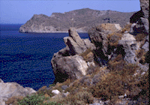
Ang Pahayag
Isinulat sa Isla ng Patmos humigit kumulang sa taong A.D. 95.
Ang Sulyap sa Kawalang-hanggang
Hinaharap sa Anim na Mahahalagang
Pangyayari…
ANG MGA SULAT SA PITONG IGLESYA
ANG TATAK NG PAGHUHUKOM
ANG TRUMPETA NG PAGHUHUKOM
ANG MANGKOK NG PAGHUHUKOM
ANG IGLESYANG TUMALIKOD SA DIOS
ANG PAGBABALIK NI HESU-KRISTO
( Ang 1 Aklat)
KAWALANG-
HANGGANG
HINAHARAP
Ang
Pahayag
70
9
Notes:
Penned by the old Apostle very near the end of his life,
//// John was exiled on the Island of Patmos about 95 A.D. That’s where the Lord gave John – and us -- a colossal view into Eternity Future.
//// John glimpses a vision of unequalled grandeur – and puzzlement –– one that has captivated Bible readers ever since its formation. In THE BIBLE…BASICALLY’s high-level view of the entire Bible, we can only provide an equally high view of this final Book of Scripture. THE REVELATION is a document of enormous argument regarding its meaning throughout the Church and across the centuries.
//// In this glimpse of Eternity Future, there are six main divisions or scenes in the Revelation that most all Bible readers agree are the main sectors of its enormous canvas. They are…
//// THE LETTERS to the seven churches…
//// THE SEAL JUDGMENTS
//// THE TRUMPET JUDGMENTS
//// THE BOWL JUDGMENTS
//// THE APOSTATE CHURCH and
//// THE RETURN OF CHRIST.

Slide 71



A FABRIC OF THE BIBLE’S CHRONOLOGY
ANG KAYO NG PAGKASUNOD-SUNOD NA PANGYAYRI SA BIBLIYA
7
NEW HEAVEN, NEW EARTH
EARTHLY REIGN OF CHRIST
4P
3S
MARRIAGE SUPPER OF
THE LAMB
GREAT WHITE THRONE
JUDGMENT
J
THE SECOND COMING
C
J
A
M
J
A
R
S
C
ABRAHAMIC COVENANT
ANG HAPONAN SA KASAL NG CORDERO
ANG PANGALAWANG PAGBABALIK NI KRISTO
LAND COVENANT
ANG DAKILANG PUTI NG TRONO NG PAGHUHUKON
ANG PAGHAHARI NI KRISTO SA SANLIBUTAN
ANG BAGONG LANGIT AT ANG BAGONG DAIGDIG
DAVIDIC COVENANT
NEW COVENANT
9.65.08.
5
©2006 TBBMI
71
Notes:
Next…you’ll remember from “The Fabric of the Bible’s Chronology” the final threads that made up the vertical weave of that mental fabric. We identified those vertical threads as
//// THE MARRIAGE SUPPER OF THE LAMB,
//// THE SECOND COMING OF CHRIST,
//// THE EARTHLY REIGN OF CHRIST,
//// THE GREAT WHITE THRONE JUDGMENT, AND
//// THE NEW HEAVEN AND THE NEW EARTH.
Again…most sectors of the Body of Christ recognize these five events, in The Revelation’s latter chapters, as significant actions that must be dealt with by the entire Creation at some future time. Slightly expanded, here they are…

Slide 72
Ang Pahayag
Isinulat sa Isla ng Patmos humigit kumulang sa taong A.D. 95.
Ang Sulyap sa Kawalang-hanggang
Hinaharap
LIMANG MATATAG NA MGA PUNTOS SA PAHAYAG: KAPITULO 19, 20, 21
( Ang 1 Aklat)
KAWALANG-
HANGGANG
HINAHARAP
Ang
Pahayag
72
9
Notes:
Penned by the old Apostle very near the end of his life,
//// John was exiled on the Island of Patmos about 95 A.D. That’s where the Lord gave John – and us -- a colossal view into Eternity Future.
//// John glimpses a vision of unequalled grandeur – and puzzlement –– one that has captivated Bible readers ever since its formation. In THE BIBLE…BASICALLY’s high-level view of the entire Bible, we can only provide an equally high view of this final Book of Scripture. THE REVELATION is a document of enormous argument regarding its meaning throughout the Church and across the centuries.
//// In this glimpse of Eternity Future, there are six main divisions or scenes in the Revelation that most all Bible readers agree are the main sectors of its enormous canvas. They are…
//// THE LETTERS to the seven churches…
//// THE SEAL JUDGMENTS
//// THE TRUMPET JUDGMENTS
//// THE BOWL JUDGMENTS
//// THE APOSTATE CHURCH and
//// THE RETURN OF CHRIST.

Slide 73
Ang Pahayag
ANG HAPONAN SA KASAL PAHAYAG 19:1-10
Ang Sulyap sa Kawalang-hanggang
Hinaharap
PAHAYAG 19:9
At sinasabi niya sa akin, “Isulat mo, ‘Mapapalad ang mga inanyayahan sa paghapon sa kasalan ng Cordero!’” At sinasabi niya sa akin, “Ang mga ito'y siyang tunay na mga salita ng Dios.”
70
9
Notes:
Penned by the old Apostle very near the end of his life,
//// John was exiled on the Island of Patmos about 95 A.D. That’s where the Lord gave John – and us -- a colossal view into Eternity Future.
//// John glimpses a vision of unequalled grandeur – and puzzlement –– one that has captivated Bible readers ever since its formation. In THE BIBLE…BASICALLY’s high-level view of the entire Bible, we can only provide an equally high view of this final Book of Scripture. THE REVELATION is a document of enormous argument regarding its meaning throughout the Church and across the centuries.
//// In this glimpse of Eternity Future, there are six main divisions or scenes in the Revelation that most all Bible readers agree are the main sectors of its enormous canvas. They are…
//// THE LETTERS to the seven churches…
//// THE SEAL JUDGMENTS
//// THE TRUMPET JUDGMENTS
//// THE BOWL JUDGMENTS
//// THE APOSTATE CHURCH and
//// THE RETURN OF CHRIST.

Slide 74
Ang Pahayag
ANG HAPONAN SA KASAL PAHAYAG 19:1-10
Ang Sulyap sa Kawalang-hanggang
Hinaharap
PAHAYAG 19:11 & 16 At nakita kong bukas ang langit; at narito, ang isang kabayong maputi, at yaong nakasakay dito ay tinatawag na Tapat at Totoo; at sa katuwiran siya'y humahatol at nakikipagbaka...
At siya'y mayroong isang pangalang nakasulat sa kaniyang damit at sa kaniyang hita, HARI NG MGA HARI AT PANGINOON NG MGA PANGINOON.
ANG PANGALAWANG PAGBABALIK
NI HESU-KRISTO
REV 19:11-16
70
9
Notes:
Penned by the old Apostle very near the end of his life,
//// John was exiled on the Island of Patmos about 95 A.D. That’s where the Lord gave John – and us -- a colossal view into Eternity Future.
//// John glimpses a vision of unequalled grandeur – and puzzlement –– one that has captivated Bible readers ever since its formation. In THE BIBLE…BASICALLY’s high-level view of the entire Bible, we can only provide an equally high view of this final Book of Scripture. THE REVELATION is a document of enormous argument regarding its meaning throughout the Church and across the centuries.
//// In this glimpse of Eternity Future, there are six main divisions or scenes in the Revelation that most all Bible readers agree are the main sectors of its enormous canvas. They are…
//// THE LETTERS to the seven churches…
//// THE SEAL JUDGMENTS
//// THE TRUMPET JUDGMENTS
//// THE BOWL JUDGMENTS
//// THE APOSTATE CHURCH and
//// THE RETURN OF CHRIST.

Slide 75
Ang Pahayag
ANG HAPONAN SA KASAL PAHAYAG 19:1-10
Ang Sulyap sa Kawalang-hanggang
Hinaharap
PAHAYAG 20:6
Mapalad at banal ang makalakip sa unang pagkabuhay na maguli: sa mga ito'y walang kapangyarihan ang ikalawang kamatayan; kundi sila'y magiging mga saserdote ng Dios at ni Cristo, at mangaghaharing kasama niya sa loob ng isang libong taon.
ANG PANGALAWANG PAGBABALIK
NI HESU-KRISTO
REV 19:11-16
ANG PAGHAHARI NI KRISTO SA SANLIBUTAN PAHAYAG 20:4-6
70
9
Notes:
Penned by the old Apostle very near the end of his life,
//// John was exiled on the Island of Patmos about 95 A.D. That’s where the Lord gave John – and us -- a colossal view into Eternity Future.
//// John glimpses a vision of unequalled grandeur – and puzzlement –– one that has captivated Bible readers ever since its formation. In THE BIBLE…BASICALLY’s high-level view of the entire Bible, we can only provide an equally high view of this final Book of Scripture. THE REVELATION is a document of enormous argument regarding its meaning throughout the Church and across the centuries.
//// In this glimpse of Eternity Future, there are six main divisions or scenes in the Revelation that most all Bible readers agree are the main sectors of its enormous canvas. They are…
//// THE LETTERS to the seven churches…
//// THE SEAL JUDGMENTS
//// THE TRUMPET JUDGMENTS
//// THE BOWL JUDGMENTS
//// THE APOSTATE CHURCH and
//// THE RETURN OF CHRIST.

Slide 76
ANG HAPONAN SA KASAL PAHAYAG 19:1-10
Ang Pahayag
Ang Sulyap sa Kawalang-hanggang
Hinaharap
ANG PANGALAWANG PAGBABALIK
NI HESU-KRISTO
REV 19:11-16
PAHAYAG 20:11-12
At nakita ko ang isang malaking luklukang maputi, at ang nakaluklok doon, na sa kaniyang harapan, ang lupa at ang langit ay tumakas; at walang nasumpungang kalalagyan nila…At nakita ko ang mga patay, malalaki at maliliit, na nangakatayo sa harapan ng luklukan; at nangabuksan ang mga aklat: at nabuksan ang ibang aklat, na siyang aklat ng buhay: at ang mga patay ay hinatulan ayon sa mga bagay na nasusulat sa mga aklat, ayon sa kanilang mga gawa.
ANG PAGHAHARI NI KRISTO SA SANLIBUTAN PAHAYAG 20:4-6
ANG DAKILANG PUTI NG TRONO NG PAGHUHUKOM PAHAYAG 20:11-15
70
9
Notes:
Penned by the old Apostle very near the end of his life,
//// John was exiled on the Island of Patmos about 95 A.D. That’s where the Lord gave John – and us -- a colossal view into Eternity Future.
//// John glimpses a vision of unequalled grandeur – and puzzlement –– one that has captivated Bible readers ever since its formation. In THE BIBLE…BASICALLY’s high-level view of the entire Bible, we can only provide an equally high view of this final Book of Scripture. THE REVELATION is a document of enormous argument regarding its meaning throughout the Church and across the centuries.
//// In this glimpse of Eternity Future, there are six main divisions or scenes in the Revelation that most all Bible readers agree are the main sectors of its enormous canvas. They are…
//// THE LETTERS to the seven churches…
//// THE SEAL JUDGMENTS
//// THE TRUMPET JUDGMENTS
//// THE BOWL JUDGMENTS
//// THE APOSTATE CHURCH and
//// THE RETURN OF CHRIST.

Slide 77
ANG HAPONAN SA KASAL PAHAYAG 19:1-10
Ang Pahayag
ANG PANGALAWANG PAGBABALIK
NI HESU-KRISTO
REV 19:11-16
Ang Sulyap sa Kawalang-hanggang
Hinaharap
PAHAYAG 21:1-2
At nakita ko ang isang bagong langit at ang isang bagong lupa: sapagka't ang unang langit at ang unang lupa ay naparam; at ang dagat ay wala na. At nakita ko ang bayang banal, ang bagong Jerusalem, na nananaog mula sa langit buhat sa Dios, na nahahandang gaya ng isang babaing kasintahan na nagagayakang talaga sa kaniyang asawa.
ANG PAGHAHARI NI KRISTO SA SANLIBUTAN PAHAYAG 20:4-6
ANG DAKILANG PUTI NG TRONO NG PAGHUHUKOM PAHAYAG 20:11-15
ANG BAGONG LANGIT AT ANG BAGONG DAIGDIG PAHAYAG 21:1-8
70
9
Notes:
Finally…THE NEW HEAVEN AND THE NEW EARTH…The Revelation 21:1-8…from verses 1 and 2: “Then I saw a new heaven and a new earth, for the first heaven and the first earth had passed away, and there was no longer any sea…I saw the Holy City, the new Jerusalem, coming down out of heaven from God, prepared as a bride beautifully dressed for her husband.”

Slide 78
ANG HAPONAN SA KASAL PAHAYAG 19:1-10
Ang Pahayag
ANG PANGALAWANG PAGBABALIK
NI HESU-KRISTO
REV 19:11-16
Ang Sulyap sa Kawalang-hanggang
Hinaharap
LIMANG MATATAG NA MGA PUNTOS SA PAHAYAG: KAPITULO 19 - 21
ANG PAGHAHARI NI KRISTO SA SANLIBUTAN PAHAYAG 20:4-6
ANG DAKILANG PUTI NG TRONO NG PAGHUHUKOM PAHAYAG 20:11-15
ANG BAGONG LANGIT AT ANG BAGONG DAIGDIG PAHAYAG 21:1-8
70
9
Notes:
FIVE ANCHOR POINTS IN THE REVELATION from CHAPTERS 19, 20, and 21…a series of apocalyptic events that, for many Bible students, tell of real events coming upon the earth. Are they true.

Slide 79
“Ang sumasaksi sa mga bagay na ito ay nagsasabi, Oo: ako'y madaling pumaparito..”
AMEN
PAHAYAG 22:20
9.65.08.
©2006 TBBMI
79
Notes:
The Bible clearly answers that. The glorious promise of Revelation says this: “He who testifies to these things says, ‘Yes, I am coming soon. Amen.’ [Rev 22:20] And so we reach the culmination of God’s great love letter to man...the grand coda to the whole body of our Scriptures…an astonishing piece of literature that concludes the entire drama of God's Plan among men...begun in 2000 B.C. with old Abraham and those covenant promises…extending through the earthly ministry of His Son, Our Lord and the price he paid for our MISSING THE MARK…giving us that gift of eternal life…while pointing us toward a glorious future time when all is made new, all is sewed up, all is concluded in that time of The New Heaven and The New Earth.

Slide 80
Pumarito ka, Panginoong Hesus!
9.65.08.
©2006 TBBMI
80
Notes:
And to that…after this Grand Tour through ALL of Scripture, we can say with great faith and hope: “Come, Lord Jesus!”

Slide 81
GABAY SA PAG-AARAL #35
9.65.08.
©2006 TBBMI
81
Notes:
Study Help #35 now shows all the 27 books of the New Testament, organized and presented in a way which encourages mental recall and interconnection of events, people and depth of meaning.

Slide 82
ANG BIBLIA...PINASIMPLE
®
“BANGYAHIN ANG 66 NA AKLAT NG IYONG BIBLIYA”
LT
BT
GABAY SA PAG-AARAL #34 & #35
9.65.08.
©2006 TBBMI
82
Notes:
Side by side…Study Helps 34 and 35…bring it all together. 39 books in the Old…27 books in the New…the entire collection of all we know…or ever need to know about God’s relationship to his Creation…from misty prehistory into the unknowable Glory of the New Heavens and the New Earth.

Slide 83
A FABRIC OF THE BIBLE’S CHRONOLOGY
ANG KAYO NG PAGKASUNOD-SUNOD NA PANGYAYARI SA BIBLIYA
7
NEW HEAVEN, NEW EARTH
EARTHLY REIGN OF CHRIST
4P
3S
MARRIAGE SUPPER OF
THE LAMB
GREAT WHITE THRONE
JUDGMENT
J
THE SECOND COMING
C
J
A
M
J
A
R
S
C
ANG KASUNDUAN KAY ABRAHAM
ANG KASUNDUAN SA LUPA
ANG KASUNDUAN KAY DAVID
ANG BAGONG KASUNDUAN
GABAY SA PAG-AARAL #28: ANG ENGRANDENG PAGLALAGOM!
83
© 2006 TBBMI
9.65.08.
Notes:
A final summing up…Study Help #28…takes us one last time to the Fabric of the Bible’s Chronology…showing that series of foundational Abrahamic Promises…the Land, Seed and Blessing…expanded into the Land Covenant, the Davidic, and the New Covenants. Seen in this entire context, one can clearly see that something is going on here…a program is working out…progressively, step by step, across four millennia.
.

Slide 84
A FABRIC OF THE BIBLE’S CHRONOLOGY
7
IPAGPATULOY NATIN ANG GAWAIN NA ATING NASIMULAN!
NEW HEAVEN, NEW EARTH
EARTHLY REIGN OF CHRIST
4P
3S
MARRIAGE SUPPER OF
THE LAMB
GREAT WHITE THRONE
JUDGMENT
J
THE SECOND COMING
HESU-KRISTO
C
J
A
M
J
A
R
S
C
ABRAHAMIC COVENANT
LAND COVENANT
DAVIDIC COVENANT
NEW COVENANT
84
1
© 2006 TBBMI
9.65.08.
Notes:
Surmounted by the appearance and ministry of Our Lord Jesus Christ. Seen on this canvas of enormous width and depth…it is obvious that each one of us has a personal mission…we have a role to play…we have a job to do. And if THE BIBLE…BASICALLY has any message of consequence, it is this: seen through this compressed, essential view of all of Scripture…recognizing the Great Commission given to us by God’s own Son…
//// So let us get on with the job at hand!

Slide 85
AT NGAYON NA TAPOS NA TAYO SA “ANG BIBLIA...
PINASIMPLE…”
ANO ANG ATING NAINTINDIHAN DITO?
9.65.08.
©2006 TBBMI
85
Notes:
We are now at the end of THE bible…basically study and content…and what has happened here?

Slide 86

®
Ang Biblia…Pinasimple ay patapos na. At sa iyong pagnilaynilay ngayon ay…
•Ang Ideya na tinawag “ SALANSAN NG BIBLIA”
9.65.08.
©2006 TBBMI
87
Notes:
We mastered that mental key to open “The Bible File”..,. C 7 S J …remembering that central seven with a dash through it: creation, four people – Abraham, Joseph, Moses and Joshua – three societies – anarchy, royalty and captivity – then, silence and finally, Jesus.

Slide 87
®
Ang Biblia…Pinasimple ay patapos na. At sa iyong pagnilaynilay ngayon ay…
•Ang Ideya na tinawag “ SALANSAN NG BIBLIA”
•Ang Pangkaisipang susi upang buksan ang “Ang Salansan ng Biblia”…P 7 K J
9.65.08.
©2006 TBBMI
87
Notes:
We mastered that mental key to open “The Bible File”..,. C 7 S J …remembering that central seven with a dash through it: creation, four people – Abraham, Joseph, Moses and Joshua – three societies – anarchy, royalty and captivity – then, silence and finally, Jesus.

Slide 88
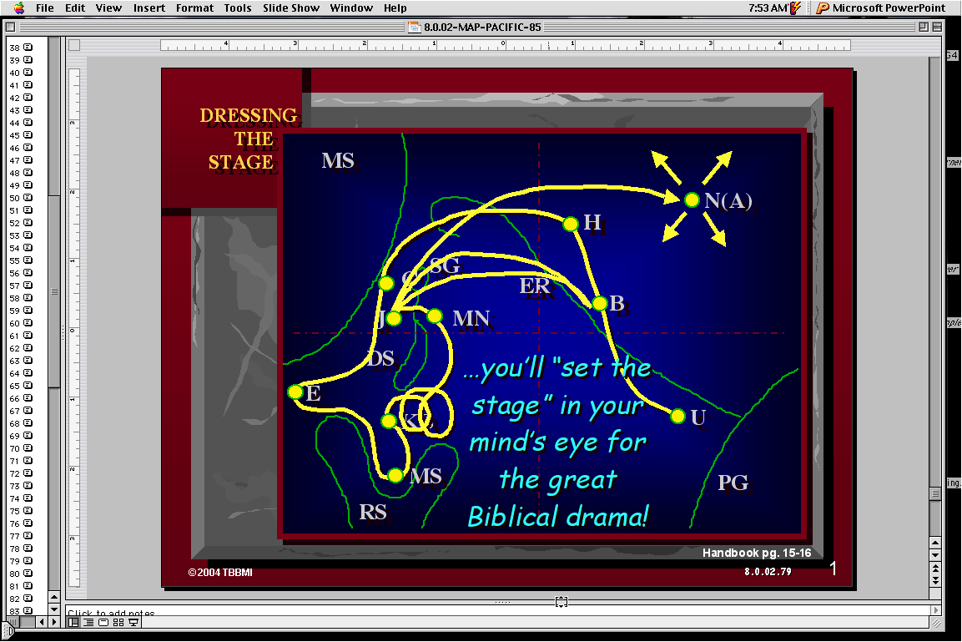
®
Ang Biblia…Pinasimple ay patapos na. At sa iyong pagnilaynilay ngayon ay…
•Ang Ideya na tinawag “ SALANSAN NG BIBLIA”
•Ang Pangkaisipang susi upang buksan ang “Ang Salansan ng Biblia”…P 7 K J
•Ang Pangkaisipang Mapa upang matagpuan ang mga Pangunahing Pangyayari sa Biblia
9.65.08.
©2006 TBBMI
87
Notes:
We mastered that mental key to open “The Bible File”..,. C 7 S J …remembering that central seven with a dash through it: creation, four people – Abraham, Joseph, Moses and Joshua – three societies – anarchy, royalty and captivity – then, silence and finally, Jesus.

Slide 89
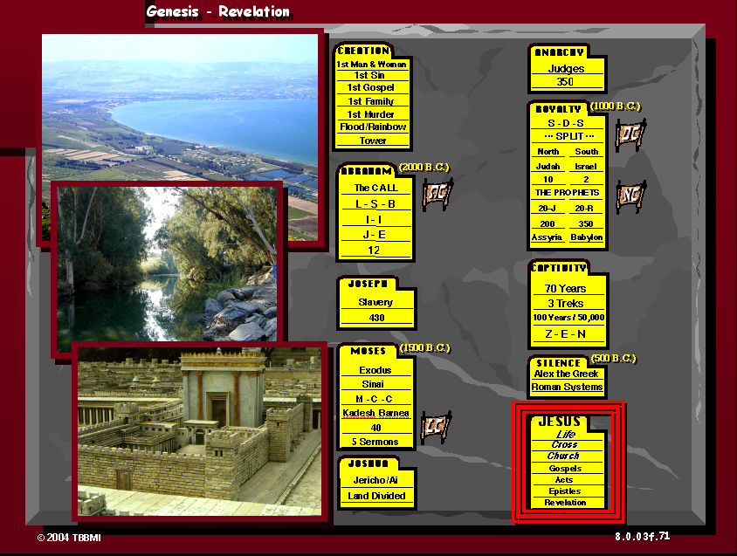
®
Ang Biblia…Pinasimple ay patapos na. At sa iyong pagnilaynilay ngayon ay…
•Ang Ideya na tinawag “ SALANSAN NG BIBLIA”
•Ang Pangkaisipang susi upang buksan ang “Ang Sakansan ng Biblia”…P 7 K J
•Ang Pangkaisipang Mapa upang matagpuan ang mga Pangunahing Pangyayari sa Biblia
•Ang Ubod na Salaysay ng Biblia: “Ang Dagliang Pagkasunod-sunod ng mga Pangyayari”
9.65.08.
©2006 TBBMI
87
Notes:
We mastered that mental key to open “The Bible File”..,. C 7 S J …remembering that central seven with a dash through it: creation, four people – Abraham, Joseph, Moses and Joshua – three societies – anarchy, royalty and captivity – then, silence and finally, Jesus.

Slide 90
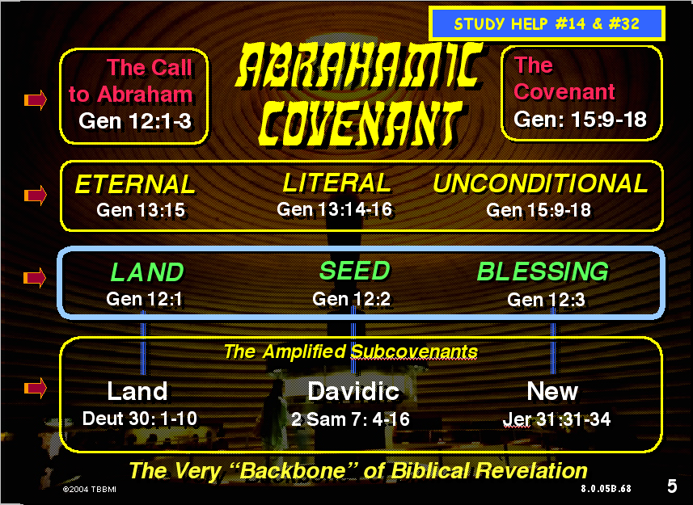
®
Ang Biblia…Pinasimple ay patapos na. At sa iyong pagnilaynilay ngayon ay…
•Ang Ideya na tinawag “ SALANSAN NG BIBLIA”
•Ang Pangkaisipang susi upang buksan ang “Ang Sakansan ng Biblia”…P 7 K J
•Ang Pangkaisipang Mapa upang matagpuan ang mga Pangunahing Pangyayari sa Biblia
•Ang Ubod na Salaysay ng Biblia: “Ang Dagliang Pagkasunod-sunod ng mga Pangyayari”
•Ang Abrahamik na pundasyon ng Banal na Salita na may direktang kaugnayan sa Ministeryo ng Panginoong Hesu-Kristo
9.65.08.
©2006 TBBMI
87
Notes:
We mastered that mental key to open “The Bible File”..,. C 7 S J …remembering that central seven with a dash through it: creation, four people – Abraham, Joseph, Moses and Joshua – three societies – anarchy, royalty and captivity – then, silence and finally, Jesus.

Slide 91
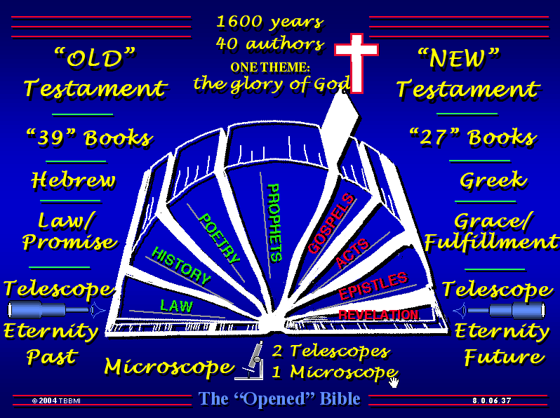
®
Ang Biblia…Pinasimple ay patapos na. At sa iyong pagnilaynilay ngayon ay…
•Ang Ideya na tinawag “ SALANSAN NG BIBLIA”
•Ang Pangkaisipang susi upang buksan ang “Ang Sakansan ng Biblia”…P 7 K J
•Ang Pangkaisipang Mapa upang matagpuan ang mga Pangunahing Pangyayari sa Biblia
•Ang Ubod na Salaysay ng Biblia: “Ang Dagliang Pagkasunod-sunod ng mga Pangyayari”
•Ang Abrahamik na pundasyon ng Banal na Salita na may direktang kaugnayan sa Ministeryo ng Panginoong Hesu-Kristo
•Sa mga Kuwento nakabase ang “Arkitektura” ng Biblia
9.65.08.
©2006 TBBMI
87
Notes:
We mastered that mental key to open “The Bible File”..,. C 7 S J …remembering that central seven with a dash through it: creation, four people – Abraham, Joseph, Moses and Joshua – three societies – anarchy, royalty and captivity – then, silence and finally, Jesus.

Slide 92
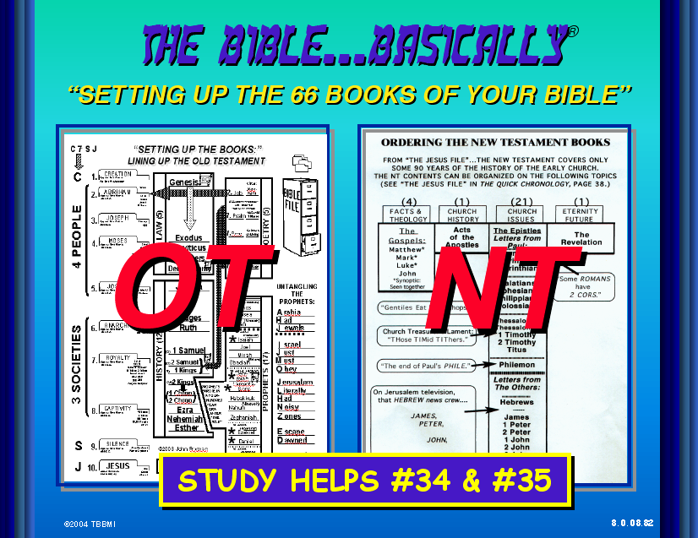
®
Ang Biblia…Pinasimple ay patapos na. At sa iyong pagnilaynilay ngayon ay…
•Ang Ideya na tinawag “ SALANSAN NG BIBLIA”
•Ang Pangkaisipang susi upang buksan ang “Ang Sakansan ng Biblia”…P 7 K J
•Ang Pangkaisipang Mapa upang matagpuan ang mga Pangunahing Pangyayari sa Biblia
•Ang Ubod na Salaysay ng Biblia: “Ang Dagliang Pagkasunod-sunod ng mga Pangyayari”
•Ang Abrahamik na pundasyon ng Banal na Salita na may direktang kaugnayan sa Ministeryo ng Panginoong Hesu-Kristo
•Sa mga Kuwento nakabase ang “Arkitektura” ng Biblia
•Ang mga Aklat at Tema ng Luma and Bagong Tipan
9.65.08.
©2006 TBBMI
87
Notes:
We mastered that mental key to open “The Bible File”..,. C 7 S J …remembering that central seven with a dash through it: creation, four people – Abraham, Joseph, Moses and Joshua – three societies – anarchy, royalty and captivity – then, silence and finally, Jesus.

Slide 93
®
Ang Biblia…Pinasimple ay patapos na. At sa iyong pagnilaynilay ngayon ay…
•Ang Ideya na tinawag “ SALANSAN NG BIBLIA”
•Ang Pangkaisipang susi upang buksan ang “Ang Salansan ng Biblia”…P 7 K J
•Ang Pangkaisipang Mapa upang matagpuan ang mga Pangunahing Pangyayari sa Biblia
•Ang Ubod na Salaysay ng Biblia: “Ang Dagliang Pagkasunod-sunod ng mga Pangyayari”
•Ang Abrahamik na pundasyon ng Banal na Salita na may direktang kaugnayan sa Ministeryo ng Panginoong Hesu-Kristo
•Sa mga Kuwento nakabase ang “Arkitektura” ng Biblia
•Ang mga Aklat at Tema ng Luma and Bagong Tipan
9.65.08.
©2006 TBBMI
87
Notes:
We mastered that mental key to open “The Bible File”..,. C 7 S J …remembering that central seven with a dash through it: creation, four people – Abraham, Joseph, Moses and Joshua – three societies – anarchy, royalty and captivity – then, silence and finally, Jesus.

Slide 94

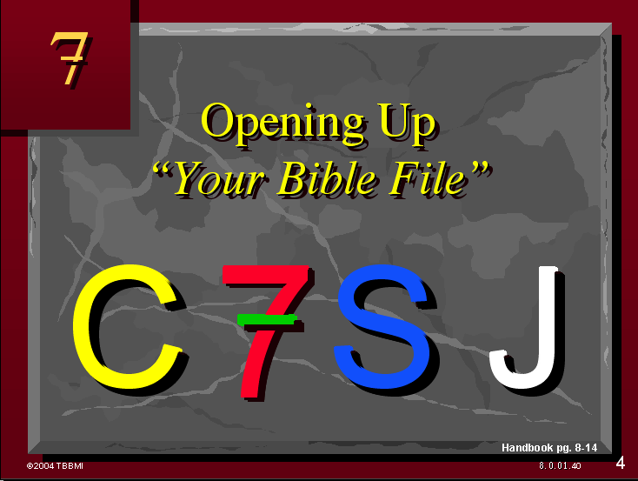
The Bible…Basically is ending. Now you have in your thinking…
®
ANG IYONG BAGONG PULOTONG NA MGA KAGAMITAN UPANG “PANGASIWAAN ANG BIBLIA NA GAMIT ANG IYONG KAISIPAN”
•An Idea Called “The Bible File”
•The Mental Key to Open “The Bible File”…C 7 S J
•A Mental Map locating The Major Biblical Events
•The Bible’s “STORY” Core: “The Quick Chronology”
•Abrahamic Foundations of Scripture leading directly to The Ministry of The Lord Jesus Christ
•The Bible’s “Architecture” Based on The Story
•The Old and New Testament Books and Themes
94
©2006 TBBMI
9.65.08.
Notes:
This new set of mental tools will allow you – once and for all – to “mentally manage the bible!”

Slide 95
NGAYON…ETO NA ANG PANAHON SA PAGTATAPOS!
KAYA NGAYON!
95
1
©2006 TBBMI
9.65.08.
Notes:
Now it’s time to wrap it all up. And here we answer that most basic of all questions:
//// “So what?”

Slide 96
Ang Biblia . . . Pinasimple
©2003 TBBMI
9.65.08.
96

Slide 97
97
©2006 TBBMI
9.65.08.

